Slide 1
Collaborative Research and
Training Experience (CREATE)
Program
February 1, 2016

Slide 2
Welcome
Team Leader: Teresa Jurewicz
Program Officer (post-award): Lauren Remmler
Program Officer (competition): Paule Boulanger
Program Assistant: Lise Bériault
CREATE@NSERC-CRSNG.GC.CA

Slide 3
Program overview
Application process
Selection criteria
http://www.nserc-crsng.gc.ca/professors-professeurs/grants-subs/create-foncer_eng.asp

Slide 4
Program objectives
CREATE supports the training of students and postdoctoral fellows from Canada and abroad through the development of innovative training programs that:
encourage collaborative and integrative approaches that address significant scientific challenges
facilitate the transition of new researchers from trainees to productive employees in the Canadian workforce

Slide 5
CREATE encourages
Enriched training experiences
Improved job readiness
Professional skills development
Industrial collaboration
Student mobility
Interdisciplinary research*

Slide 6
Qualities of successful CREATE initiatives
Innovative nature
Rich training environment
Excellence of the researchers and their training success
Capacity to raise the standard for best practices in training
Promoting collaboration and international awareness

Slide 7
Value of the Grant
Year 1: up to $150,000
Years 2 – 6*: up to $300,000 per year
Total: up to $1,650,000
Non renewable

Slide 8
Expectations
*Year 2-6 funding is dependent on positive performance evaluations by NSERC.
Regular progress reports are required
Must demonstrate that proposed objectives, training elements, HQP targets, etc., are being met.
i.e. applicants are held accountable and must follow through on what is promised in the proposals.

Slide 9
Allowable expenses
At least 80% to trainee stipends
Up to 30% of this may go toward non-NSE trainees
Remaining 20% may be used for…
Trainee travel (conferences, exchanges, internships, etc).
Training program administration (e.g. salary of program coordinator; first 2 years only)
Dissemination of training materials
etc.
Note that travel costs of the applicants and collaborators are not eligible.

Slide 10
Trainee stipends
No minimum or maximum
May be complemented by other sources
Supervisors
Collaborators
Scholarships
stipend from CREATE is not a requirement for trainee participation in the initiative
Emphasis of the initiative must be on graduate students, but undergraduate and postdoctoral trainees may also be supported

Slide 11
Teams leading CREATE initiatives
A complementary group of researchers
From eligible Canadian universities
For multi-university applications: must have at least one co-applicant involved for trainees at that institution to be eligible to receive CREATE stipends
Work collaboratively to offer a defined training program to a group of trainees
Supporting Gender Representation and Advancement

Slide 12
Teams leading CREATE initiatives
Conditions
Tenable at NSERC-eligible Canadian universities
Lead applicant must be from an NSERC-supported field at an NSERC-eligible university
At least 70% of the group must be in NSE (co-applicants may be from other fields)
Participation in maximum of two active CREATE initiatives

Slide 13
Program committee
Program committee (PC) consisting of a variety of stake holders, e.g.
Potential future employers of graduates
Collaborators
Curriculum developers
Trainees
Program evaluation and guidance

Slide 14
Addressing Research Priorities
At least 60% of CREATE funding will be directed to priority areas:
Environmental science and technologies
Natural resources and energy
Manufacturing
Information and communications technologies

Slide 15
Streams
Regular stream CREATE may involve any collaborations: academic/government/industry/NGO, Canadian/international
CREATE + Germany’s DFG-IRTG: for collaboration with German researchers
CREATE + Sao Paulo’s FAPESP: for collaboration with Sao Paulo researchers
Industrial stream CREATE: required industrial participation

Slide 16
Industrial Stream
Up to 50% of CREATE grants are dedicated to industrial stream applications.
Increased emphasis on preparing trainees for non-academic careers; enhanced academic-industrial collaboration
Requires participation of industrial collaborators on the program committee
Requires industrial internships of at least 20% of their studies

Slide 17
Industrial collaborators
Canadian-based businesses, able to exploit the research results for the economic benefit of Canada.
International companies eligible if activities related to the proposed research take place in Canada (e.g. R&D, manufacturing); if their participation will result in a benefit to Canada.

Slide 18
Application Procedures
Phase 1: Letter of Intent
Phase 2: Application (if invited)

Slide 19
Phase 1: Letter of Intent
Selection process & criteria
Internal selection at university (quota based)
CREATE Selection Committee
Merit of proposed training program (60%)
Excellence of the research team (40%)

Slide 20
Phase 1: Letter of Intent
Form 187: Letter of Intent to Apply for a CREATE
List co-applicants (min 1, max 10)
Collaborators
Referee suggestions (6)
LOIs will not be sent for external review

Slide 21
Phase 1: Letter of Intent
Personal Data Form (Form 100)
Letter from VP Research of the lead university

Slide 22
Phase 1: Letter of Intent
Outline of Training Program (2 pages)
Objectives
Novelty
How trainees would be better prepared for careers
Involvement of stakeholders
Description of potential future employers, assessment of job prospects for trainees

Slide 23
Phase 1: Letter of Intent
Excellence of Proposed Team (2 pages)
Complementarities
Expertise
Roles, responsibilities
Training experience

Slide 24
Phase 2: Full application
Selection process & criteria
Only if invited
Criteria:
Merit of proposed training program (50%)
Excellence of the research team (25%)
Program management and sustainability (25%)

Slide 25
Phase 2: Full application
Personal data form (Form 100) for the applicant
Personal data form (Form 100) or CCV for all co-applicants (max 10)
One letter from the lead applicant’s university
Support, financial commitments
Up to 3 letters from collaborators, if applicable
Nature of support

Slide 26
Phase 2: Full application
Form 102 – Application for a CREATE grant
Application profile
Plain language summary of proposal
Co-applicants and collaborators
Proposed expenditures

Slide 27
Phase 2: Full application
Research training program proposal
(free-form, 12 pages + 1 for references)
Objectives
Elements of the training program
Estimated number of trainees
Job prospects
Program Committee

Slide 28
Phase 2: Full application
Budget justification (free form, 2 pages)
Support from other sources (free form, 2 pages)
Maximum 1 Letter of support from lead university:
List of all contributions from the university
Describe the details of support
Involvement in the training program
Plans to ensure sustainability

Slide 29
Additional requirements for industrial stream applications
Skills identified as needed for a career in industry
Description of improved job-readiness for industry sector
Details about trainee internships

Slide 30
Additional application requirements for industrial stream
Letter of Intent (phase 1)
ONE e-mail/letter from industry partner confirming:
Willingness to participate on the program committee
Intent to host internships

Slide 31
Additional application requirements for industrial stream
Application (phase 2)
Max 3 letter(s) from industry partner(s) confirming
Commitment to participate on the program committee, with confirmed name of the industrial member
Commitment to host trainee internships of at least 20% of the duration of trainees’ studies. Agreements must be in place and should be guaranteed (may be dependent on success of application).

Slide 32
Application procedures for
DFG collaborations
Phase 1
Pre-proposal at DFG
Phase 2
German researchers submit full application to DFG
Canadian researchers submit full application to NSERC

Slide 33
Application procedures for
FAPESP collaborations
LOI at NSERC with brief joint plan
Application at NSERC and FAPESP review
Selection process
Funding decision

Slide 34
Competition statistics
 | 2013 | 2014 | 2015 | 2016
LOIs received: | 103 | 120 | 125 | 114
Candidates invited: | 50 | 48 | 48 | 52
Applications received: | 48 | 47 | 45 | 52
Grants awarded: | 15 | 15 | 17 | Up to 17

Slide 35
Important Dates
March/April: Letter of Intent deadline (Univ.)
May 1: Letter of Intent deadline (NSERC)
June 30: Invitation to submit application
September 22: Application deadline (NSERC)
March: Notification of results

Slide 36
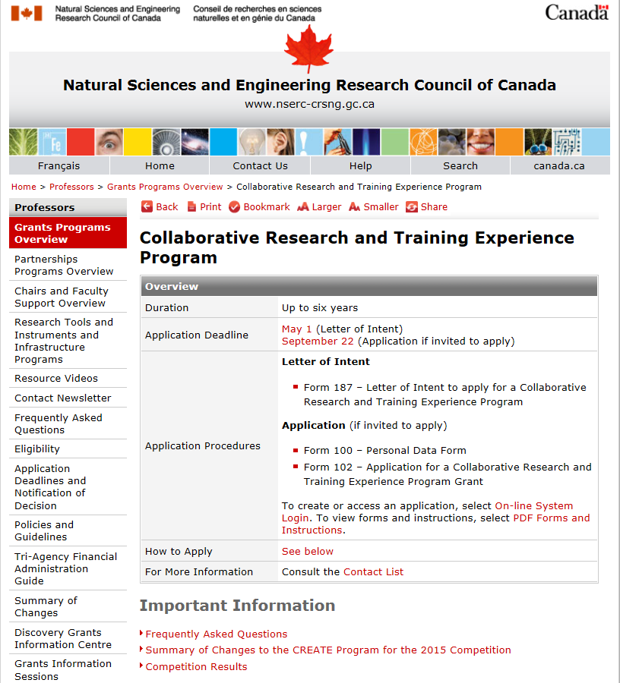
Program description:
http://www.nserc-crsng.gc.ca/professors-professeurs/grants-subs/create-foncer_eng.asp

Slide 37
Information
Program description:
www.nserc-crsng.gc.ca/Professors-Professeurs/Grants-Subs/CREATE-FONCER_eng.asp
Team Leader: Teresa Jurewicz
Program Officer (competition): Paule Boulanger
Program Officer (post-award): Lauren Remmler
Program Assistant: Lise Bériault
E-mail: CREATE@nserc-crsng.gc.ca
Tel: 613-943-1363

