Slide 1
Alberta Innovates-
Technology Futures (AITF)
Overview Presentation
August 25, 2015

Slide 2
Alberta’s economic evolution
Economic Diversity: 1985
Percentage Distribution of GDP
Total GDP: $67.6 Billion
Economic Diversity: 2013
Percentage Distribution of GDP
Total GDP: $338.2 Billion
Sources: Statistics Canada, Alberta Treasury Board and Finance and Alberta Innovation and Advanced Education
Page 2

Slide 3
Mandate & Role
Achieve economic and social benefit for Albertans (ESBA) using research and innovation to grow industry …
Research and innovation activities that develop and grow Alberta’s technology sectors.
Aligned to Government of Alberta’s priorities, including the commercialization of technology and the application of knowledge.
Meet Alberta’s research and innovation priorities in agriculture, forestry, energy, the environment, health, and other ministries.
Foster development and growth of new existing industries through research and innovation.
Page 3

Slide 4
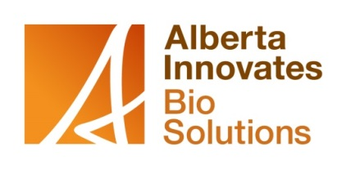


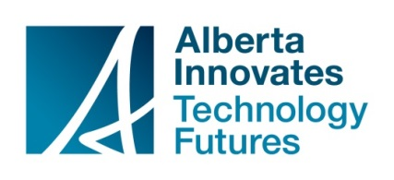
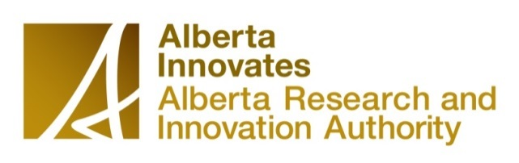
Alberta Innovates
Sector focus where Alberta has a competitive advantage
  Energy: oil sands, oil and gas, pipelines, tight oil & fracking
  Carbon Conversion, Capture and Storage
  Environmental Monitoring and Management
  Industrial Sensors
  Advanced Materials and Manufacturing
  Sustainable Resources: agriculture and forestry
  Health Research and Technologies
A provincially funded cohesive, accessible research and innovation system
World-class research to support Alberta priorities
Coordinates and supports investments required to solve major industry challenges
Notes:
Note to Karen: Some of these items go across sectors – e.g. environmental monitoring, carbon management, sensors
The Alberta Innovates group, through its corporations, has a well-respected reputation for delivering credible science through its internationally peer-reviewed research funding programs.
· The members of the five boards of the AI group are domestic and international leaders in industry and academia offering direction and advice based on well-respected global experience and sector expertise.
· We work together contributing special skills and capabilities at different stages – from funding research generating breakthrough ideas, to connecting researchers with business and industry partners; from pilot-testing new products, to providing business advice in the commercialization phase.
· Our interconnectedness as an AI group and to the broader innovation system along with the Alberta Innovates Connector service makes it easy for researchers, innovators and investors to connect for optimum results with the right experts, programs and services, no matter their touch-point.

Slide 5
What’s AITF?
90+ years of operational experience.
520 world-class scientists, engineers, technologists, technicians and business experts (nearly 100 employees have Ph.D.s).
1 million square feet of research space.
1,000+ industry clients annually.
$75 million generated by fee for service work annually.

Slide 6
What does AITF do?
Collaborates with technical industries to find solutions, develop products and move technologies to market.
Builds upon platform technologies to enhance the technical capacity within Alberta's high-tech companies (including nanotechnology, information communications technologies, and genomics).
Facilitates access to key partners that help support commercialization and grow new ventures.
Invests in and attracts research and entrepreneurial talent to support these priorities.

Slide 7
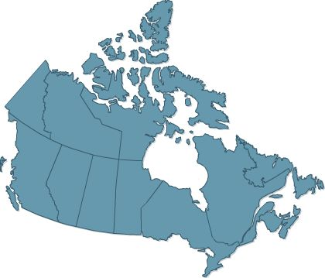
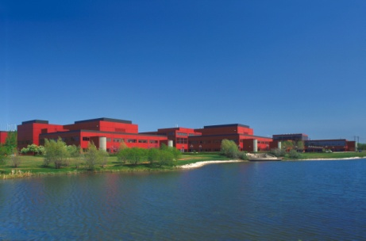
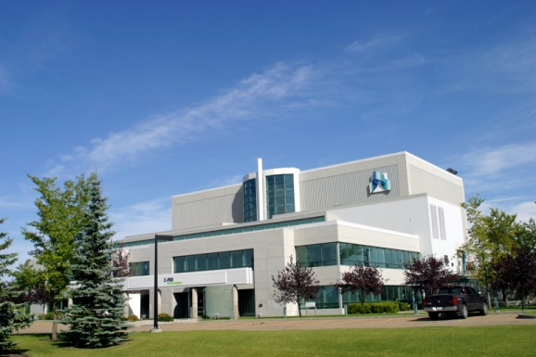
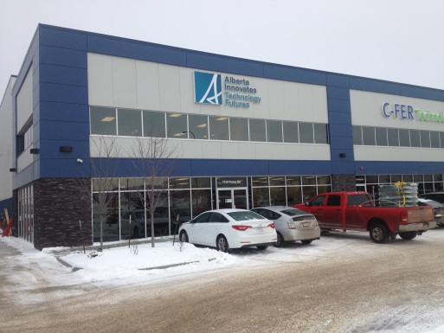
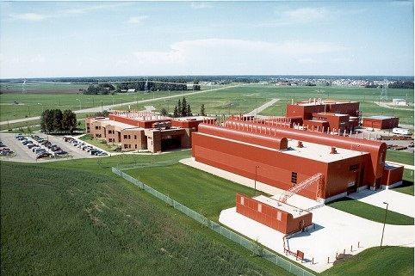
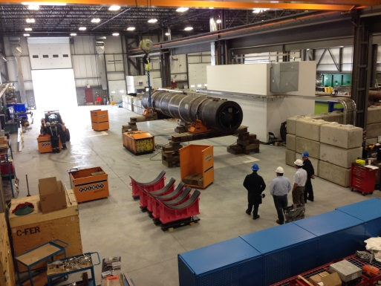
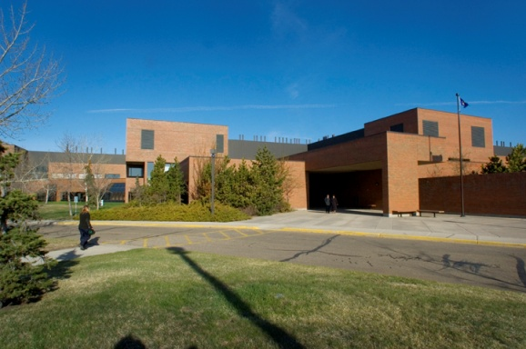
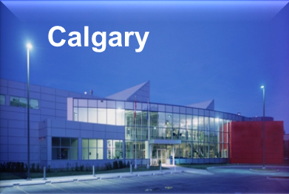
AITF Locations
Edmonton
Edmonton
(C-FER Technologies)
Edmonton
(IST at Pylypow)
Devon
Edmonton
(C-FER Technologies)
Vegreville

Slide 8
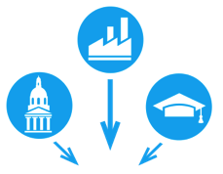







Strategic Direction
Focused
Innovation
Our strategic objectives refreshed our approach to delivering on our mandate and helped determine how we execute …
Grand Challenges
Alberta’s Innovation System
Contribute
to Effective Innovation System
Basic Research > Applied Research > Commercialization
In partnership with IAE, Campus AB, AI Corps, Regional Innovation Networks, etc.
Engaged
Stakeholders
Operational
Excellence
Food & Fibre
Environment
Oil & Gas
Pipelines
Health
Investments & Legal
Science
Office
Operations
Organization Effectiveness
Accounting
& Finance
High
Performance
Culture

Slide 9

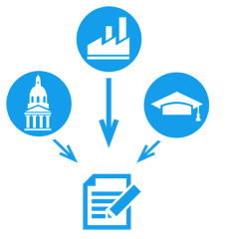
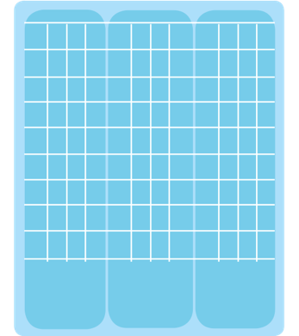
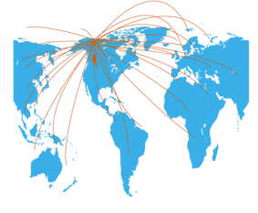





Operating Model
Design
Coordinate
Implement
Monitor
Sector Strategies
Economic
and Social Benefits
to Alberta
Market Adoption
Grand
Challenges
Discovery/Innovation
Sustainable
Prosperity
Basic
Research
>
Applied
Research
> Commercialization
In partnership with IAE, Campus AB, AI Corps, Regional Innovation Networks, etc.
Platform Technologies
Contribute to Innovation System Design
Identify Priorities
Resource
& Fund
Execute Sector Strategies
Monitor &
Validate Outcomes

Slide 10
Executive Team
Stephen
Lougheed
CEO
Cory Fries
VP Investments
& Legal
Randy Goebel
VP Science Office
Sandra Scott
EVP Operations
Caroline Conway
VP Talent & Org.
Effectiveness
Denis Plumb
VP Finance
Corporate Planning
Portfolio Management Office
Investments and Transactions
IP Services
Legal Services
Corporate Secretariat
Ensure Science Excellence
Recruit HQSP
Guide Basic Research Programs
Bring international research perspectives to sector and platform strategies
(next page)
Talent Management
HR Services
Organization Change and Culture
IT Services
Facilities Management
Communications
Accounting
Financial Reporting
Auditor General Relationship

Slide 11
Operations
Sandra Scott
EVP Operations
Sector Leadership
Ross Chow
Oil & Gas
Brent Lakeman
Environment
Barry Mehr
Food & Fibre
Richard Wayken
Pipelines
Don Back
Health
Kirk Rockwell
Basic Research
Marius Ghinescu
Applied Research
Rollie Dykstra
Commercialization

Slide 12
Sectors
Sandra Scott
EVP Operations
Sector Leadership
Ross Chow
Oil & Gas
Brent Lakeman
Environment
Barry Mehr
Food & Fibre
Richard Wayken
Pipelines
Don Back
Health
Kirk Rockwell
Basic Research
Marius Ghinescu
Applied Research
Rollie Dykstra
Commercialization

Slide 13
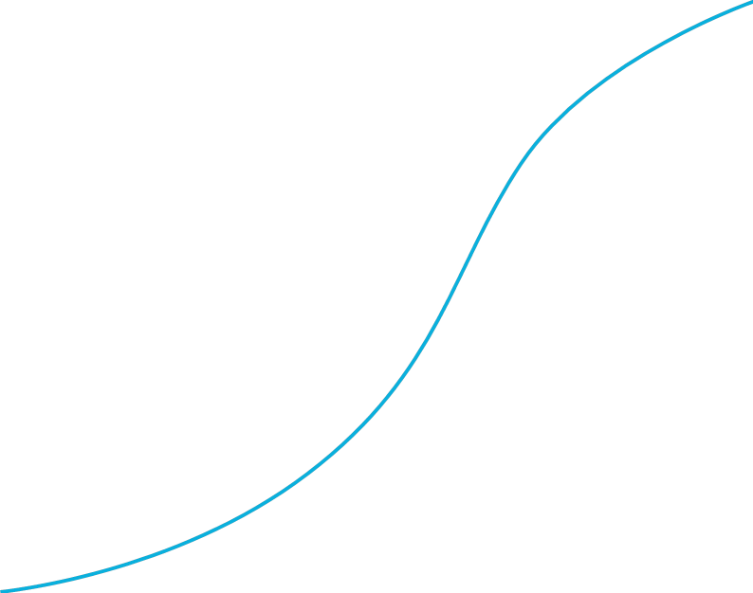
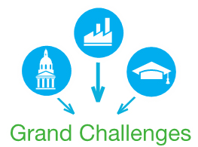
Sector Strategies
Sector Leadership
Ross Chow
Oil & Gas
Brent Lakeman
Environment
Barry Mehr
Food & Fibre
Richard Wayken
Pipelines
Don Back
Health
Investment Portfolio
ESBA
^{Commercialization}
^{(Short-Term)}
^{Applied Research}
^{(Mid/Short-Term)}
$$$
Long Term Funding
^{Basic Research (Long-Term)}

Slide 14
Oil & Gas: Heavy Oil & Oil Sands
Specialized expertise, facilities and equipment for:
In-situ recovery of heavy oil and bitumen (including technologies for reservoir processes, production and surface separation)
  Contract R & D
  AACI Research Program
  Tight Oil
Surface mining process (including technologies for enhancing recovery and tailings treatment).
Engineered materials.
Page 14

Slide 15
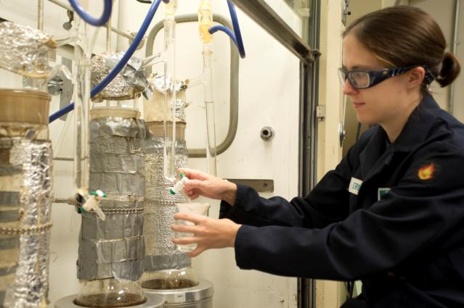
Oil & Gas: Fuels & Lubricants
Specialized laboratory characterizations
and quality assurance services for:
Oil and gas
Refining
Renewable fuels
Full-service, nationally recognized laboratory’s capabilities cover full range of characterizations, from liquid petroleum gas to refined products and crude oil assays to bitumen.
The laboratory maintains ISO 17025 accreditation through Standards Council of Canada.
Page 15

Slide 16
Oil & Gas related consortia
Alberta Metal Fab Innovation Program (AMFI)
Professional development program to enhance understanding of modern fabrication technologies through hands-on demonstrations.
Materials and Reliability in Oil Sands (MARIOS)
Develops knowledge and validates technologies to significantly reduce downtime, and improve operational reliability and productivity in the oil sands industry.
Pipeline Integrity and Corrosion Management (PICoM)
Evaluates and improves corrosion monitoring methods for midstream and downstream petroleum operations.
Page 16

Slide 17

Environment
Environmental monitoring
Environmental management
Climate change solutions
Page 17

Slide 18
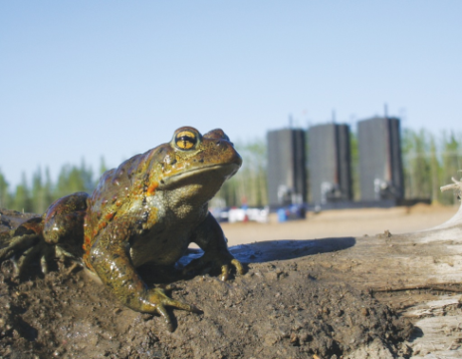
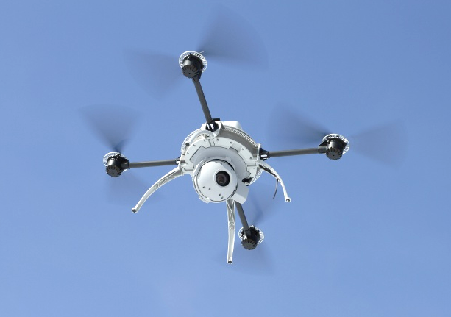
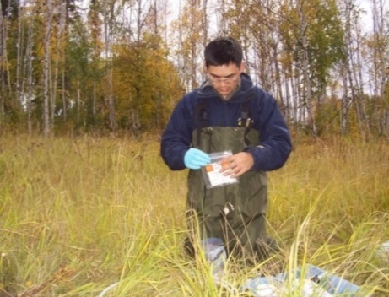
Innovations in Environmental Monitoring
Support AEMERA priorities, bringing together resources of innovation system
Data collection
  Alberta Biodiversity Monitoring Institute (ABMI)
Technology de-risking
  Pipeline monitoring and leak detection
  CCUS Monitoring
Systems integration
  Eco-site mapping
Science and analysis
  Advanced environmental analysis
  Napthenic acids and oil sands process waters
  Faster forest creation
Notes:
There are high expectations that Alberta excel at both energy production and environmental protection - we can have it both ways.
Alberta has created an agency to oversee environmental monitoring – beginning in the oil sands region.
The provincial arms-length environmental monitoring system will be unlike any other in Canada and the world.
Its centrally-coordinated system will integrate the monitoring, evaluation and reporting of air, land, water and wildlife. The information will be scientifically credible, accessible and open.
It’s important to note that while the monitoring agency is new, considerable monitoring already takes place… (Alberta as a gateway to rest of Canada in monitoring technologies??)
AITF has highly-regarded experience in the effective management of monitoring systems
Testing variety of technologies and approaches
Sensors development and deployment for industrial applications
Advanced analytical services and protocols
Applications in CO₂ Storage monitoring, reclamation monitoring, groundwater wildlife monitoring

Slide 19
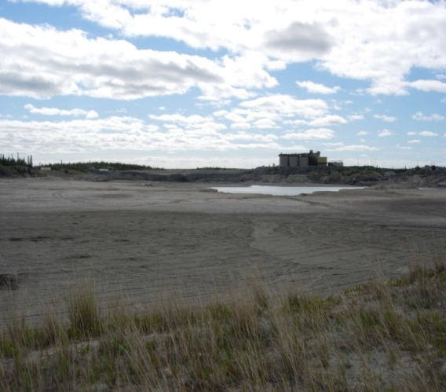
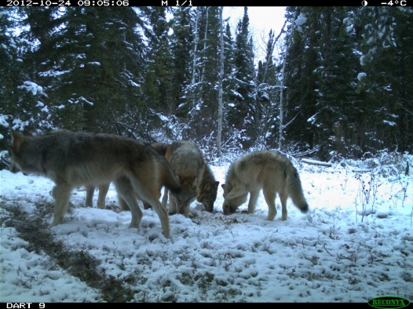
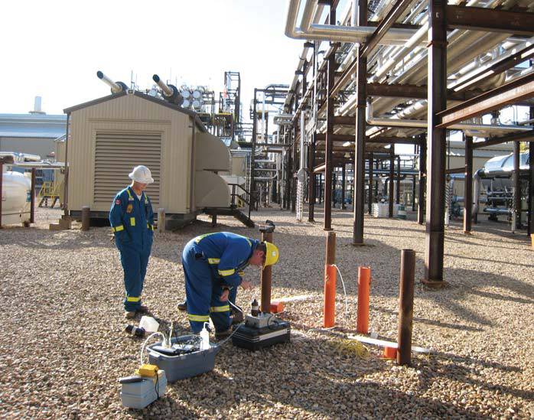
Environmental Management
Ecological conservation
Reclamation and remediation
Water management
Notes:
Alberta needs a more effective and efficient management system that considers the cumulative effects of all activities. The current system is evolving and adapting to place-based challenges, which allows decision-makers to see the big picture and help those on the landscape to be more strategic and responsible in their development activities.
AITF helps build sustainable resource management capacity through research, development and deployment of scientifically valid ecosystem management tools.

Slide 20
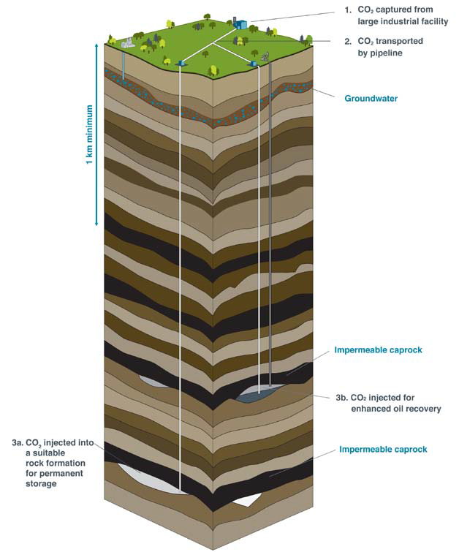
Climate Change Solutions
Advancing CO₂ utilization and storage for over 25 years
  Characterization
  Modelling
  Monitoring
Notes:
Alberta is a responsible resource developer and accepts its responsibility to reduce its greenhouse gas emissions. This is a difficult challenge as we are an energy economy and the world demand for energy continues to grow. We must reduce our absolute emissions while we increase energy production and grow our economy.
Technology development is the answer. We know we need to stimulate innovation and transformative technology. Incremental improvements will not get us there.
AITF addresses environmental concerns across multiple industry sectors: including geological storage of GHG, sensing technologies, cleaner conversion technologies for hydrocarbons, waste heat and energy re-use, and anaerobic digestion of biomass.
Advancing CO₂ utilization and storage for over 25 years
Characterization
Modelling
Monitoring
Supporting leading North American projects, including Shell Quest, Alberta Carbon Trunk Line, Weyburn
Canada-US collaboration via North American Clean Energy Dialogue, CSLF, Regional Partnership Program, NETL

Slide 21

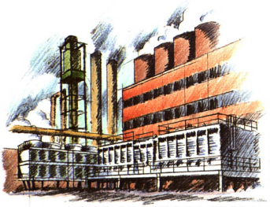


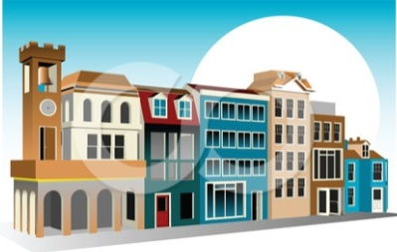
Climate Change Solutions
Energy systems integration
  Energy mapping
  Energy storage
200⁰ C
50⁰ C Heat
Notes:
Energy systems integration
Energy mapping
Energy storage

Slide 22
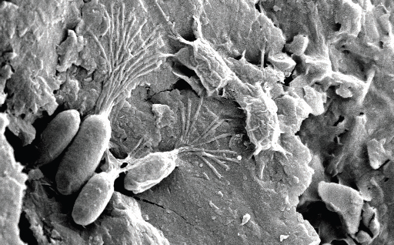
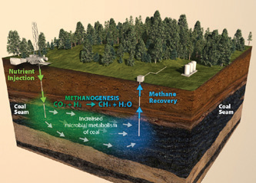
Climate Change Solutions
Carbon conversion
  Chemical looping combustion for CO₂ capture
  Bio-energy
  Methanogenesis in coals
Notes:
Carbon conversion
Chemical looping combustion for CO₂ capture
Biogas innovation
Methanogenesis in coals and microbial enhanced oil recovery

Slide 23
Food & Fibre
Takes holistic “From seed to final product” approach to helping industry design, develop, demonstrate and commercialize new bio-refining processes and value-added products.
Provides expertise and technologies in biotechnology, biomass feedstock development, bio-processing, bio-conversion and bio-materials engineering.
Key initiatives AITF supports include:
  Alberta Biomaterials Development Centre (ABDC)
  Alberta Biochar Initiative (ABI)
  Engineered Composite products lab
  Cellulose Nanocrystals (CNC) pilot plant
  Industrial hemp
  Crop disease detection and mitigation
Page 23

Slide 24
Food & Fibre
Biotechnology and genomics. New traits discovery and development to enhance the productivity and quality of Alberta food, feed and fibre crops. Genomics tools to support environmental projects related to monitoring and remediation.
Feedstock development. Working in the crop industry, with an emphasis on crops with industrial applications, i.e. hemp and flax
Biomass processing technologies. Developing and demonstrating leading-edge technologies for handling and adding value to Alberta bio-fibre resources and resource recovery from agricultural and forest waste materials.
Engineered composite products. Developing new bio-fibre products for emerging markets. Developing, optimizing and demonstrating composite materials, processes and products.
Page 24

Slide 25
The Canadian Pipeline Technology Collaborative
(www.thecptc.ca)

Slide 26
CPTC: Canadian Pipeline Technology Collaborative
The CPTC unites pipeline operators, researchers, technology providers and supply chain partners to pursue responsible advancement of pipeline operations and technology development.
Hub to align and focus currently distributed resources to improve the reliability and safety of Canadian pipeline operations.
Co-founded by the Canadian Energy Pipeline Association (CEPA), Canadian Association of Petroleum Producers (CAPP) and AITF.
Page 26

Slide 27
Health
Solutions that successfully bridge the gap between product research and market development.
Chemical synthesis: complex carbohydrate and drug synthesis and analysis; LpxC enzyme substrates.
Microbial fermentation: production scale-up from 20L up to 15,000L.
Non-Clinical Services: efficacy, toxicology and pre-IND studies.
ISO 9001 and ISO 13485 Quality Management Consultant services.
Page 27

Slide 28
Basic Research
Sandra Scott
EVP Operations
Sector Leadership
Ross Chow
Oil and Gas
Brent Lakeman
Environment
Barry Mehr
Food-Fibre
Richard Wayken
Pipelines
Don Back
Health
Kirk Rockwell
Basic Research
Marius Ghinescu
Applied Research
Rollie Dykstra
Commercialization

Slide 29
Basic Research Investments
34 Strategic and Industrial Chairs.
11 Strategic and Industrial Centres.
20 Post Doctoral Fellowships.
289 Graduate Student Scholarships.
Visiting Research awards.
Strategic Networking and Development awards.

Slide 30
Building Basic Research Capacity
Demand for Basic Research Program investments requires work to align Campus Alberta supply with Sector demand, vetted by an effective portfolio management process.
Sector demand also creates Science Office search in Campus Alberta and all international networks.

Slide 31
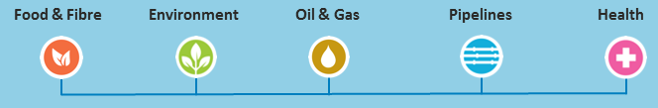
Platforms
Grand Challenge Opportunities
Platform Research Support
Platform Strategies
Nanotechnology
ICT
Omics

Slide 32
Applied Research
Sandra Scott
EVP Operations
Sector Leadership
Ross Chow
Oil and Gas
Brent Lakeman
Environment
Barry Mehr
Food-Fiber
Richard Wayken
Pipelines
Don Back
Health
Kirk Rockwell
Basic Research
Marius Ghinescu
Applied Research
Rollie Dykstra
Commercialization

Slide 33
Applied Research
Value Proposition:
Industry focussed (de-risks new technologies through pilot and large-scale testing facilities).
Internationally recognized scientific capacity.
1,000+ customers annually; $75 million in “fee for service” work.
Key Industry Programs:
AACI Industry Consortium, Materials & Reliability in Oil Sands (MARIOS) Industry Consortium, Alberta Manufacturing & Fabrication Innovation (AMFI) Program, Alberta Bio-Char Initiative, and others.

Slide 34
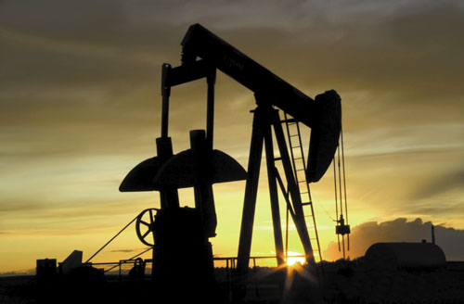
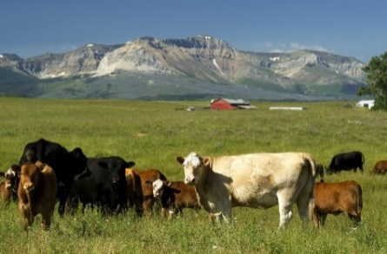
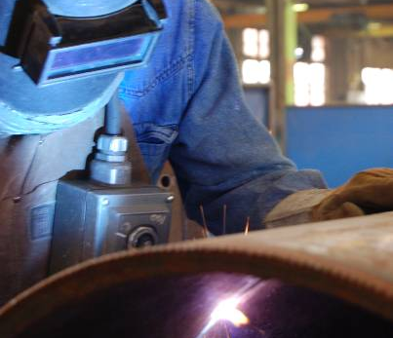
Applied Research Focus
Energy (Oil Sands, Oil and Gas, Pipelines, Tight Oil & Fracking)
Sustainable Resources (Agriculture & Forestry)
Materials and Manufacturing
Environmental Monitoring and Management
Carbon Conversion, Capture and Storage
Industrial Measurements
Health Research & Technologies

Slide 35
Commercialization
Sandra Scott
EVP Operations
Sector Leadership
Ross Chow
Oil and Gas
Brent Lakeman
Environment
Barry Mehr
Food-Fiber
Richard Wayken
Pipelines
Don Back
Health
Kirk Rockwell
Basic Research
Marius Ghinescu
Applied Research
Rollie Dykstra
Commercialization

Slide 36
Commercialization
The Commercialization team provides 4 key services to SMEs
Funding Support - Capital - Capital
Connecting to Sector Strategies
System Partnerships
Mentoring – Business Advice
Key Requirements
Micro-vouchers, Vouchers, Industry Associates
Access to private capital
i.e. Venture capital, strategic investors, private investors, foundations, and angel investors
Key Requirements
Technology development advisors, business advisors, executives in residence, AITF staff
Key Requirements
Product demonstration program
SME introduction to grand challenges as participants
Key Requirements
Regional Innovation Networks, Campus Alberta, TRTech, CETAC West

Slide 37
Commercialization Programs
Regional Innovation Networks / Technology Development Advisors
Micro Voucher
Voucher
Industry Associates
10-100K for SMEs
E.g. Design, engineering, prototype development, product testing, patents
Technologies in mid to late developmental stages
Product Demonstration
0-10K for SMEs
Technologies in the early developmental phases
E.g. Market or IP assessments, business plan development, material purchase
55K Annual Stipend and 7K Research allowance
Addresses the growing need for research personnel in Alberta industry
Increases research expertise in Alberta-based companies
100-300K for SMEs
Technologies in advanced stage of development
E.g.. Prototype demonstration, technology optimization, regulatory approval

Slide 38
Collaboration Programs
Strategic intent, geographic focus, or SME development:
  Alberta-Ontario Innovation Program
  Alberta-Finland Innovation and Commercialization Program
  Entrepreneur Accelerator
    Productivity Ed-Tech Challenge
    Telus
    GE Licensing Partnership
Brings innovation to Alberta and provides access to international and interprovincial markets

Slide 39
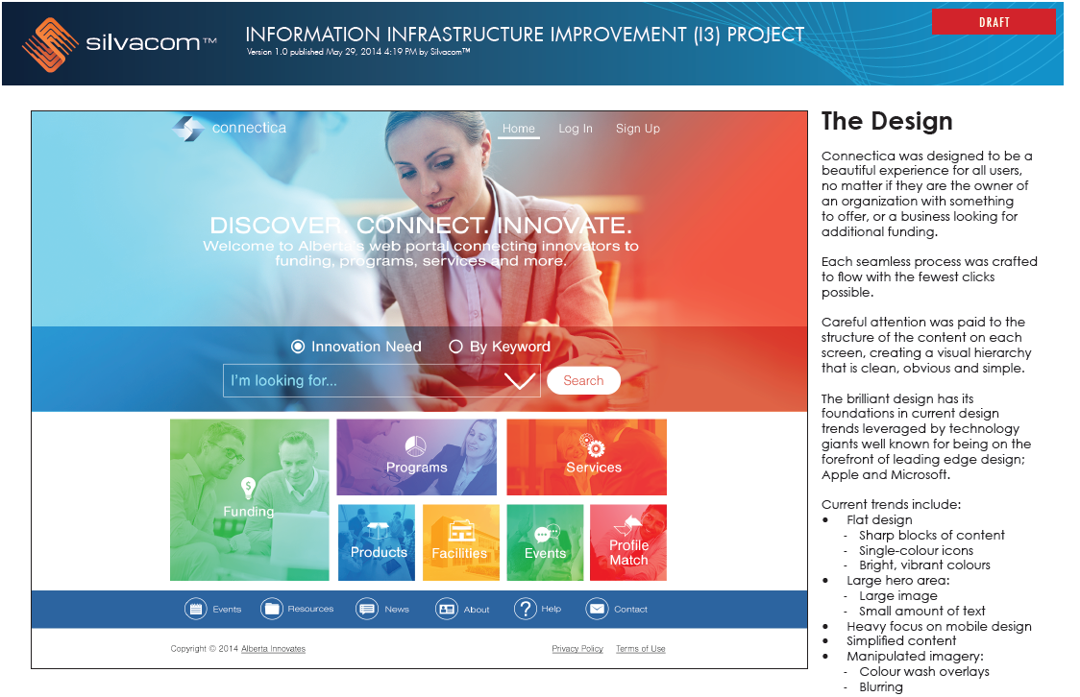

Slide 40
Centres for Research and Commercialization
AITF supports four centres that foster technology development and advance product commercialization.
Alberta Centre for Advanced MNT Products (ACAMP) Micro and nanotechnology products
Alberta Glycomics Centre - Carbohydrate-based medical therapeutics
Home to GlycoNet – Canadian Glycomics Network
Alberta Innovates Centre for Machine Learning (AICML) Sophisticated data analysis
TECTERRA - Geomatics technologies

Slide 41
Maximizing Return on Innovation
Design
Coordinate
Implement
Monitor
Sector Strategies
Economic
and Social Benefits
to Alberta
Market Adoption
Grand
Challenges
Discovery/Innovation
Sustainable
Prosperity
Basic
Research
>
Applied
Research
> Commercialization
In partnership with IAE, Campus AB, AI Corps, Regional Innovation Networks, etc.
Platform Technologies
Contribute to Innovation System Design
Identify Priorities
Resource
& Fund
Execute Sector Strategies
Monitor &
Validate Outcomes

Slide 42
Thank you!

