Slide 1
Make grading easier with Crowdmark
John Dawson
Jan 26, 2017

Slide 2
What’s the number one frustration you experience with exam grading?
As a TA?
As an instructor or prof?
What about as a student?
Notes:
What about handing back the exams?
Entering innumerable grades into the gradebook by hand
The shuffling of papers -- inefficient
Mistakes with math
Entering grades – by hand in a class of 1000 students
There’s rich data that we are losing – performance on specific questions gets lost when we only report out / capture the overall grade
3560 – handing back the midterm – been an issue comes up every so often – one year we had a room booked with a staff person manning the room to hand exams back -- resources

Slide 3
Today…
What Crowdmark is
What Crowdmark does
How I used it in BIOC*3560 in the Fall
Practical issues – pros and cons
Data you can derive from Crowdmark and how you might use that
What’s next?

Slide 5
The Usual Way
1
2
3
4
5

Slide 6
With Crowd-mark
1
2
Match exams with students
3
4
5

Slide 7
1. Create Exam
Print one file; staple every X pages
Notes:
3.5 cm header blank
Integrated with Courselink – imports student information: email, st ID, names
Tells the CM site how many to print – you also can add additional copies

Slide 8
2. Administer the Exam
Distribute exams / scantrons
Students sign attendance card
Have them write their exam number
Count students
Collect unused exams
Record which are unused
Calculate how many are out there
Match assessments to students
Smart phone App – use the camera on your phone!

Slide 9
Matching Students to Assessments
Exam Matcher app for your phone
Create unique tokens for your exam
Identify student
Scan their code
Matched!

Slide 10
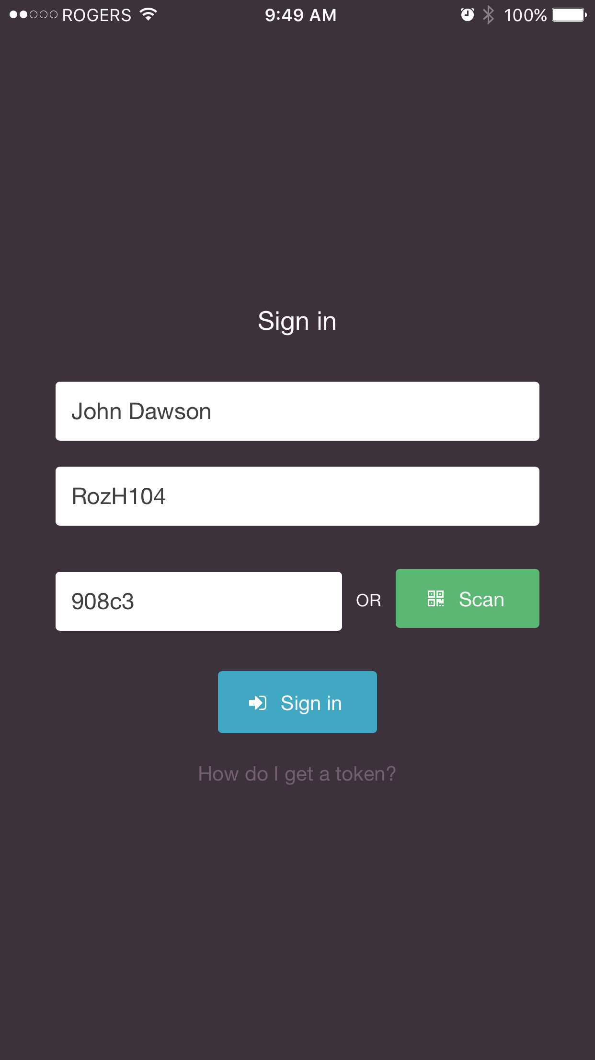
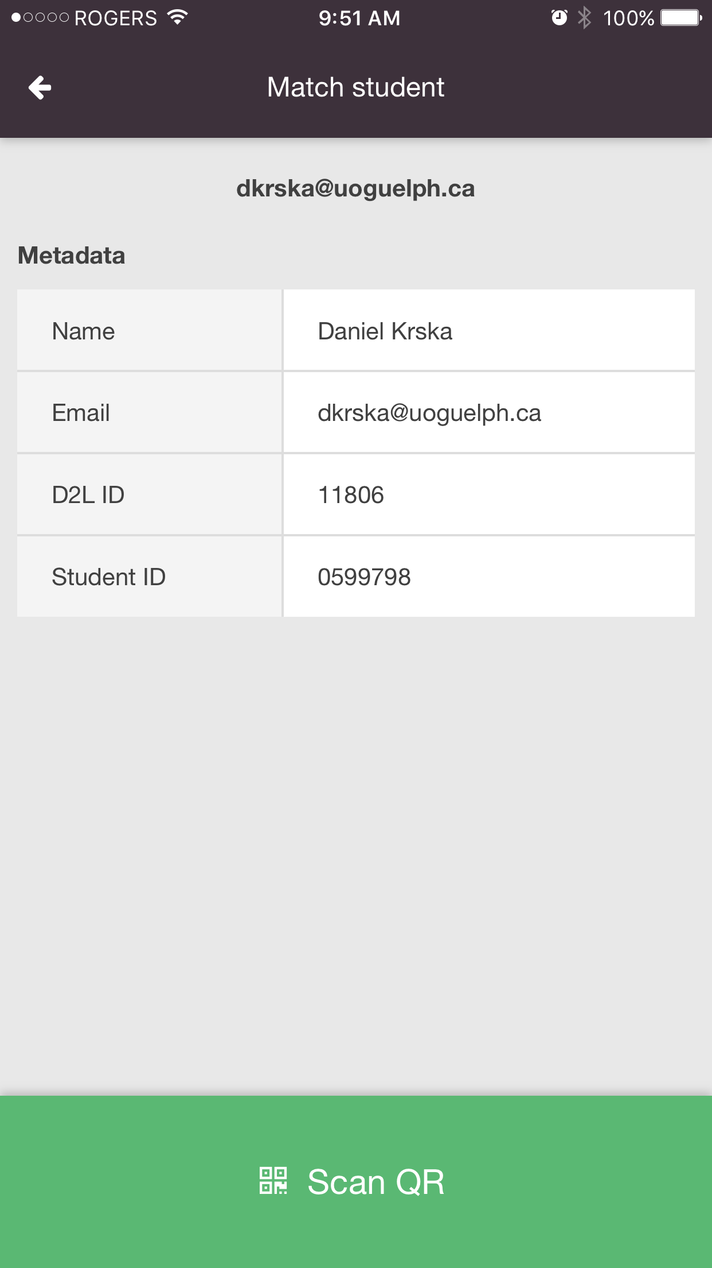
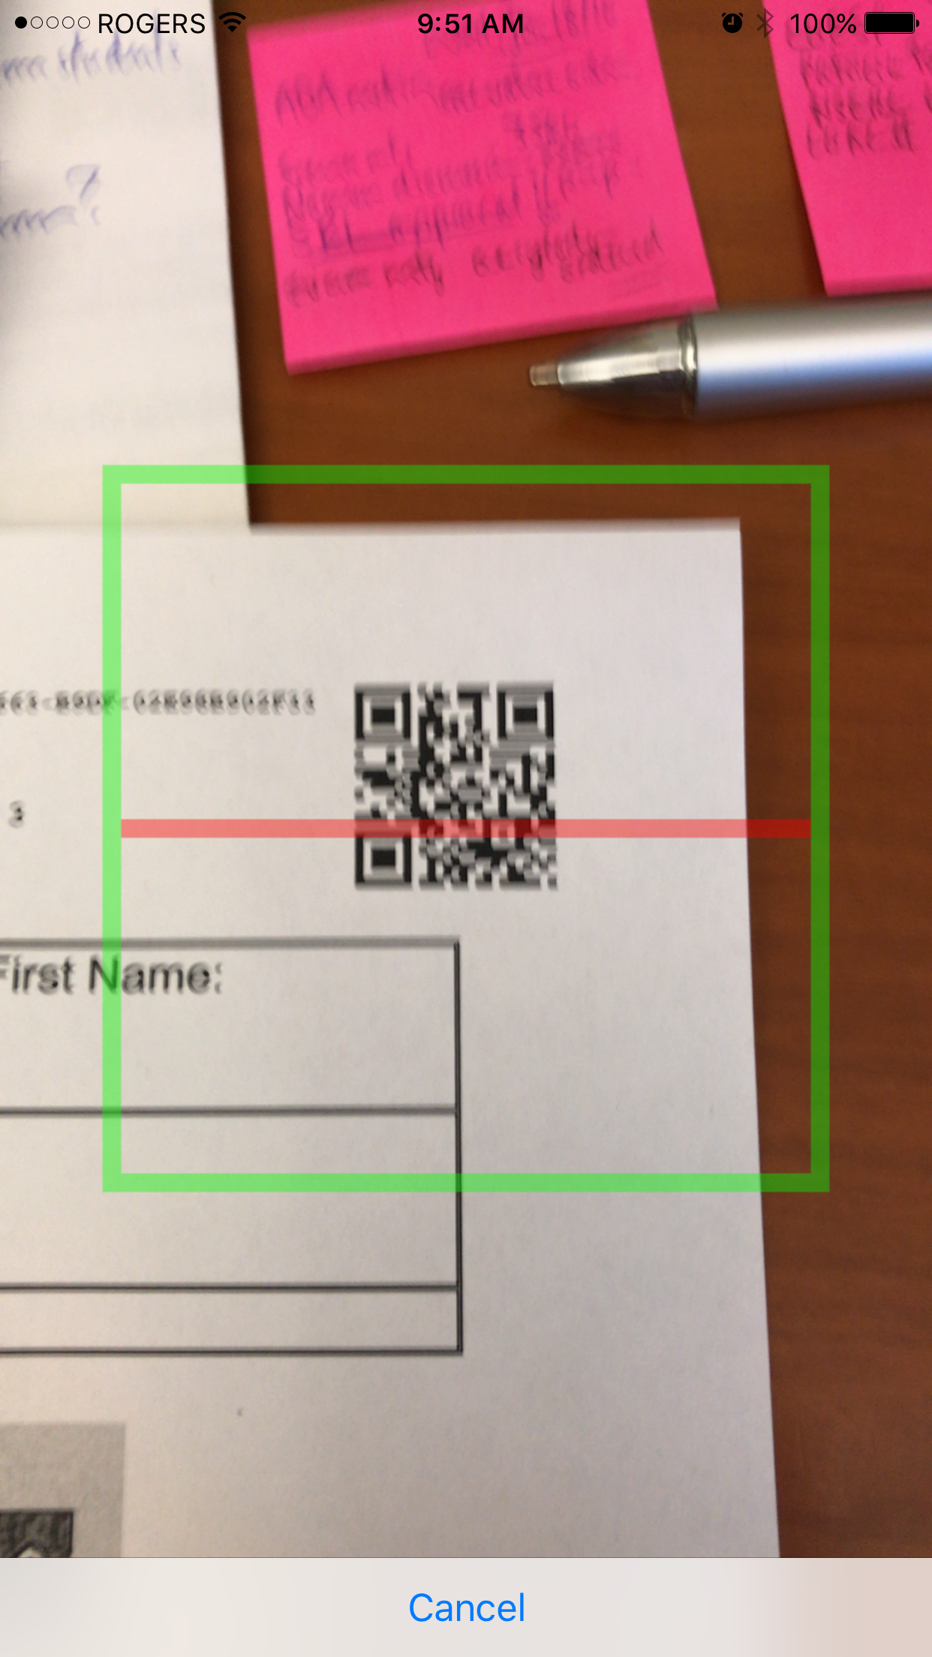
Matching Students to Assessments
2 exams/min
6 people
327 exams
All done in
30 min
Scanning Student Cards
Notes:
Something you are required to do anyway – collecting the attendance cards and checking the

Slide 11
Students for this mock final
908c3
5f669
3eea3
7eeb9
demo_bioc2580
dkrska
dsychant
dvitsupa
swhite02

Slide 12
Immediately After the Exam
Ordered the exams by number
Folders of 10 exams each
Confirmed that we had all of the exams
Cross-check with list of unused exams
30 min

Slide 13
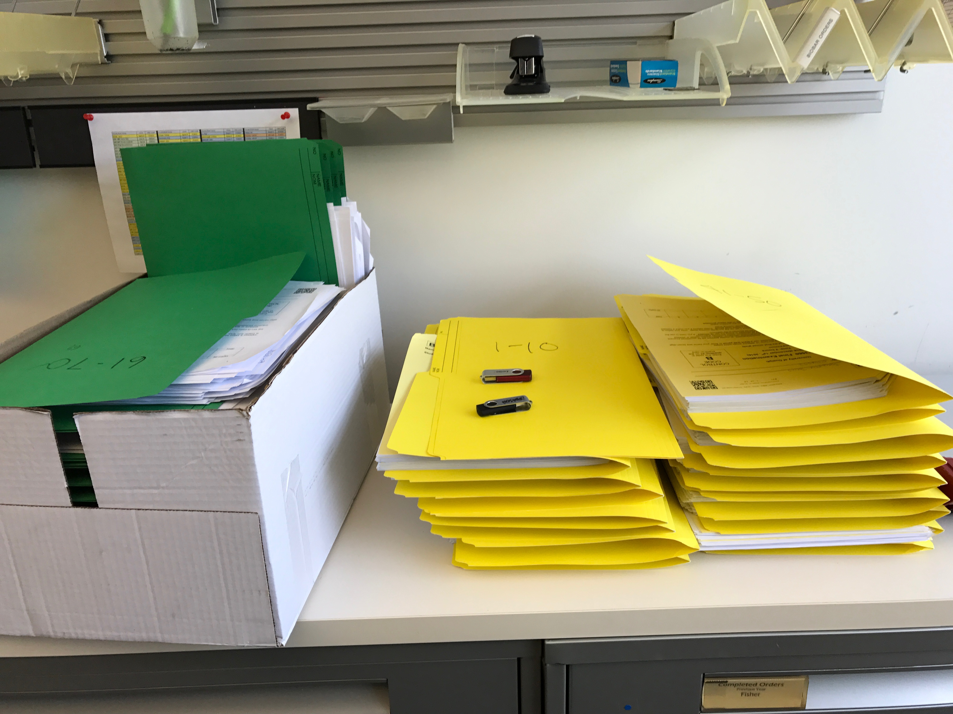
3. Grading the Exam!
50 min
2 photocopiers
SCANNING THE EXAMS
The extra step in Crowdmark
Cut off the stapled corners
Scan using Departmental photocopiers
160 pages (10 exams) in 83 sec
240 pages is about the max / go
327 exams on 2 memory sticks
Notes:
How could you save more time?
Only scan the short answer questions – first 9 pages were not even looked at
This would have cut the scanning time in half – to 30 minute -- but you’d have to have 2 booklets.

Slide 14
Uploading the files to Crowdmark
Upload to scans to Crowdmark
Fix errors
Folded over QR codes
Organizing all exams by page and exam number
Uploading 30 min
~1.6 GB
Fixing errors 10 min
7 pages / over 5200
Notes:
What are you doing for that 30 minute? Having lunch

Slide 15
READY TO GRADE ONLINE!
We did the usual thing –
Went through the questions
Calibrated the grading
45 min

Slide 16
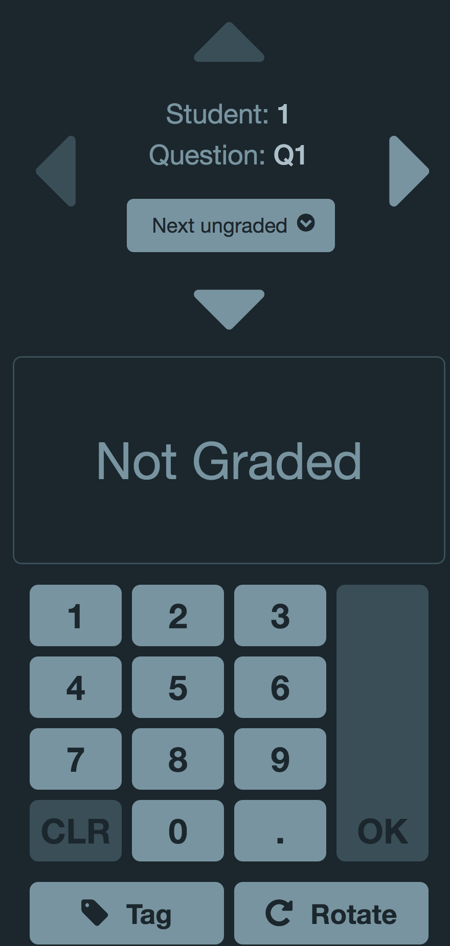
The grading experience
Notes:
Or there are shortcuts to checks and x’s
Cons!

Slide 17
Pros and Cons - Grading
Pros
You can grade from anywhere
No passing papers
Click to go to the next one
Grade the same exam simultaneously
See which questions have been graded or not
No taking papers home
See progress of grading – total time taken to grade a question
See performance on questions “on the fly”
Cons
No ½ mark symbols
Only the final grade on the whole page recorded (no sub-sections)
Need good wi-fi! (SSC issues..)

Slide 18
4. Returning Exams / Entering Grades

Slide 19
Student’s view
I took a screen shot, just like my students would.
Alternatively, students scan or take pictures of their exams

Slide 20
Pros and Cons – Entering Grades
Pros
Click one button to send to exam to every student
No rooms booked
No staff time taken
Click one button to tabulate and enter all the grades into Courselink
No alphabetizing
No math mistakes
No time entering by hand
Cons
Every student now has an electronic version of the exam (only for midterms!)
Grades are sent “in the clear”

Slide 21
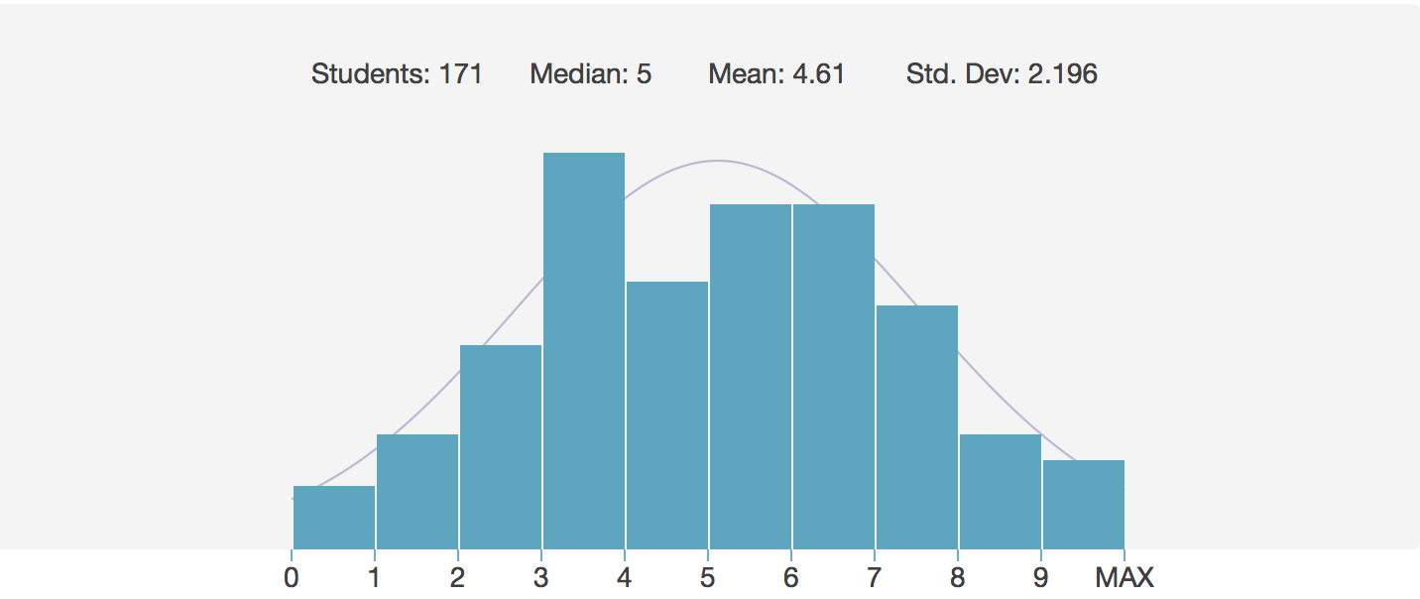
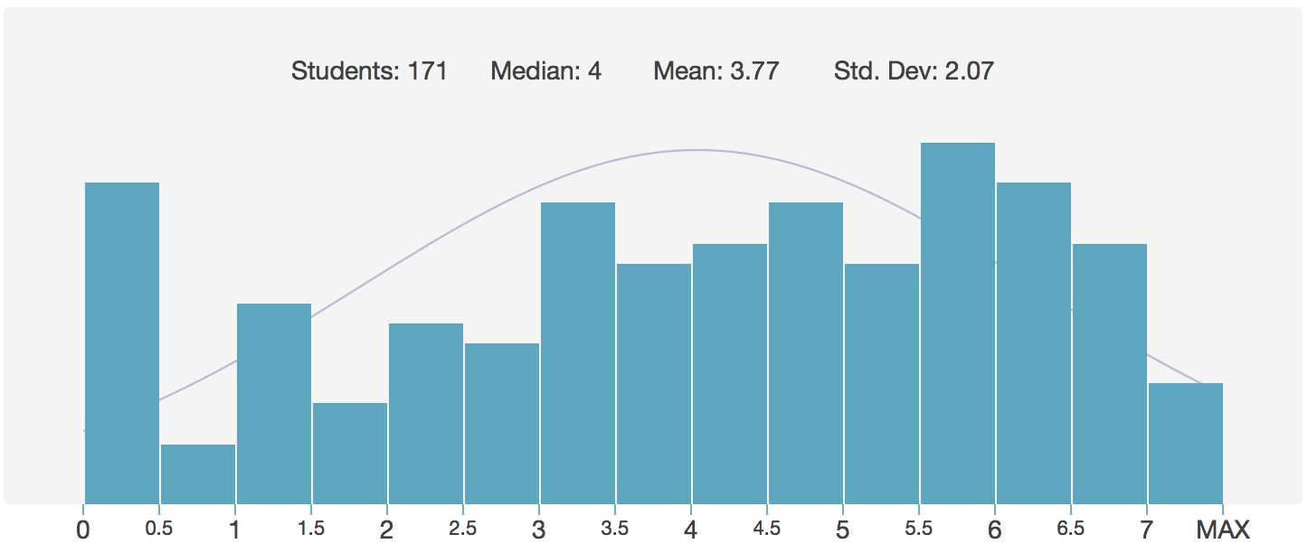
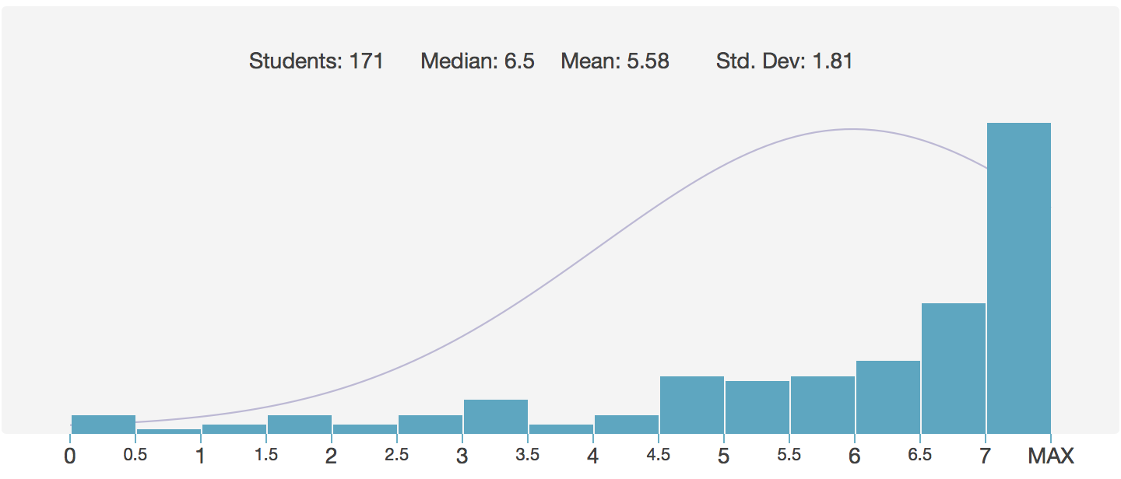
Pro: You get more information!
Performance data for each page is captured
Can use to evaluate
the quality of the questions
underperforming outcomes
Overall
Q13
Q10
Q11

Slide 22
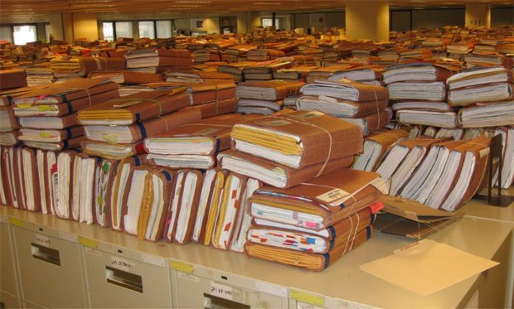
After the grades are submitted
Midterm regrading requests
No manipulation of the midterm
Requests to see the final exam
Show the exam on the computer
Easy to find that student
Long term storage of exams
Must keep exams for 1 semester
Replace boxes of papers in your office?

Slide 23
Crowdmark Summary
Does it really save time?
Spent 1.5 hours scanning, uploading and fixing errors
Saved time in the physical set up of the grading
Saved time in the alphabetizing and entering grades
No math mistakes
Does it benefit the student?
Graders spend more energy on grading, less on logistics
They get access to their midterms automatically
We get information on the performance on questions
Improve our courses
Improve our assessments

Slide 24
What’s next?
Crowdmark is currently being piloted by CPES
Scanning student cards for matching
Splitting MC from SA booklets to save on copying time
Analyzing the data for course / assessment improvement

