Slide 1
The Rural History Roundtable invites you to…
Household and Economy
In a Changing World 1830-1930
7 March 2014 at the Lifetime Learning Centre 1713 (OVC)
14:30
Peter Baskerville, University of Alberta
The Last Best West: Homesteaders on the Move, Alberta 1870-1916
15:15
Catharine Wilson, University of Guelph
Work Groups and Neighbourhoods in Ontario 1830-1930
16:00 break
16:15
Fabio Faria Mendes, Universidade Federal do Vicosa
Crossing Borders: Intermarriage, Heterogamy and Social Networks in Waterloo County 1870-1902
17:00
Gordon Darroch, York University
Reconstructing Household Experience with Canada’s Historical Censuses

Slide 2
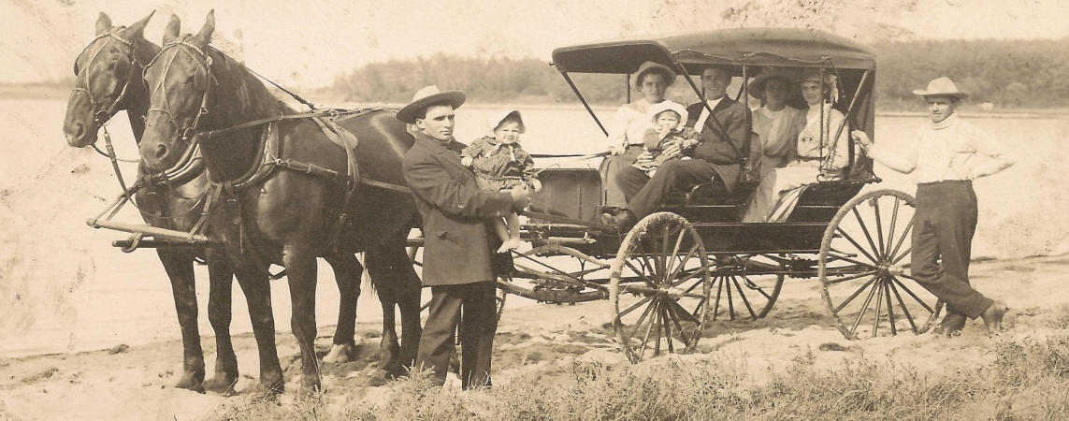
The Rural History Roundtable invites you to …
Household and Economy
In a Changing World 1830-1930
7 March 2014 at the Lifetime Learning Centre 1713 (OVC)
14:30
Peter Baskerville, University of Alberta
The Last Best West: Homesteaders on the Move, Alberta 1870-1916
15:15
Catharine Wilson, University of Guelph
Work Groups and Neighbourhoods in Ontario 1830-1930
16:00 break
16:15
Fabio Faria Mendes, Universidade Federal do Vicosa
Crossing Borders: Intermarriage, Heterogamy and Social Networks in Waterloo County 1870-1902
17:00
Gordon Darroch, York University
Reconstructing Household Experience with Canada’s Historical Censuses

