Slide 1
U of G Virtual Graduate Preview Week 2020
Art History and Visual Culture
College of Arts
Presenters:
Dominic Marner – Graduate Program Coordinator, dmarner@uoguelph.ca
Loryssa Quattrociocchi – Alumnus
Barb Merrill – Producer/Moderator
Website: https://www.uoguelph.ca/arts/sofam/ma-arthistory

Slide 2
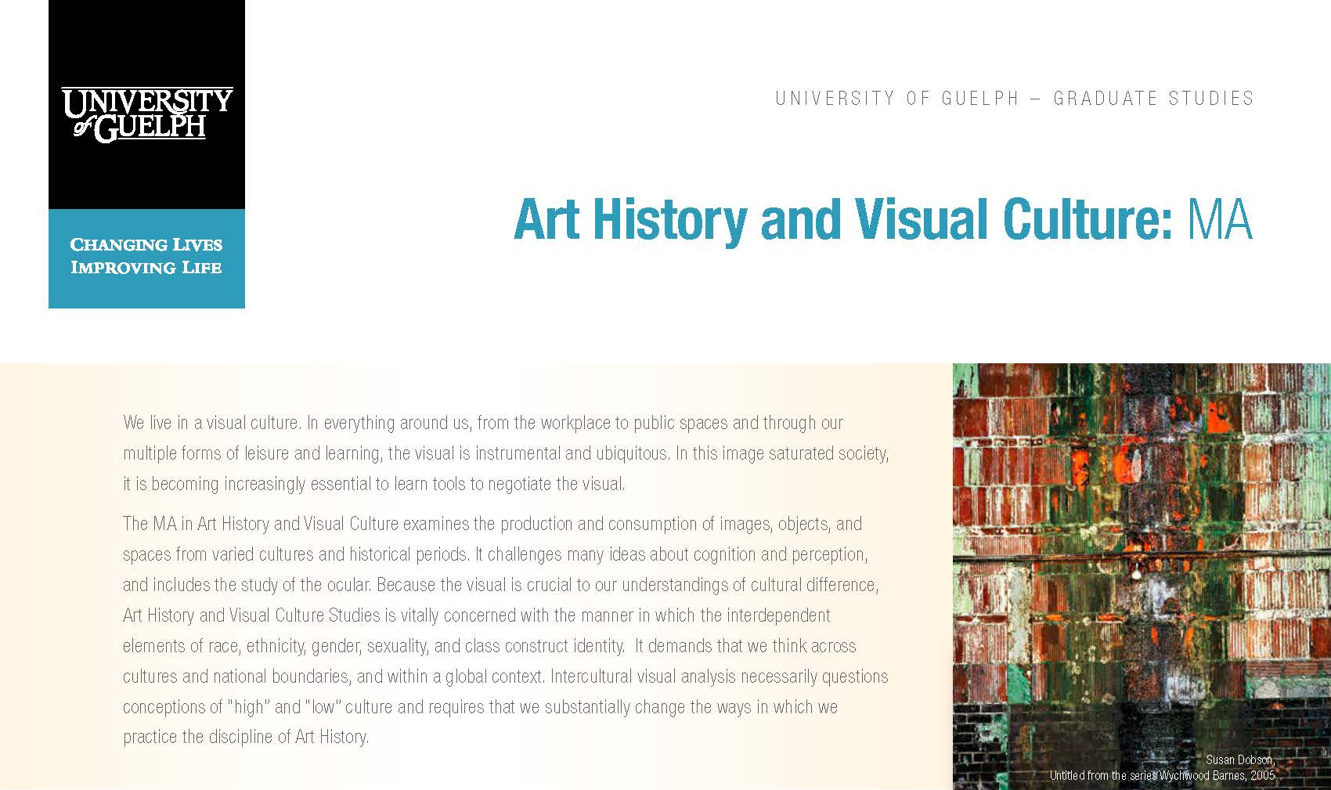

MA.AHVC

Slide 3
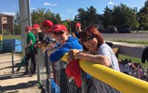

MA.AHVC
Faculty
Programs
Events
Opportunities
Community
Alumni
Admissions
Funding
Contact

Slide 4
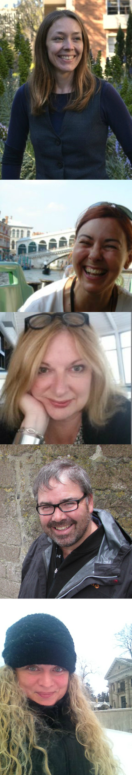
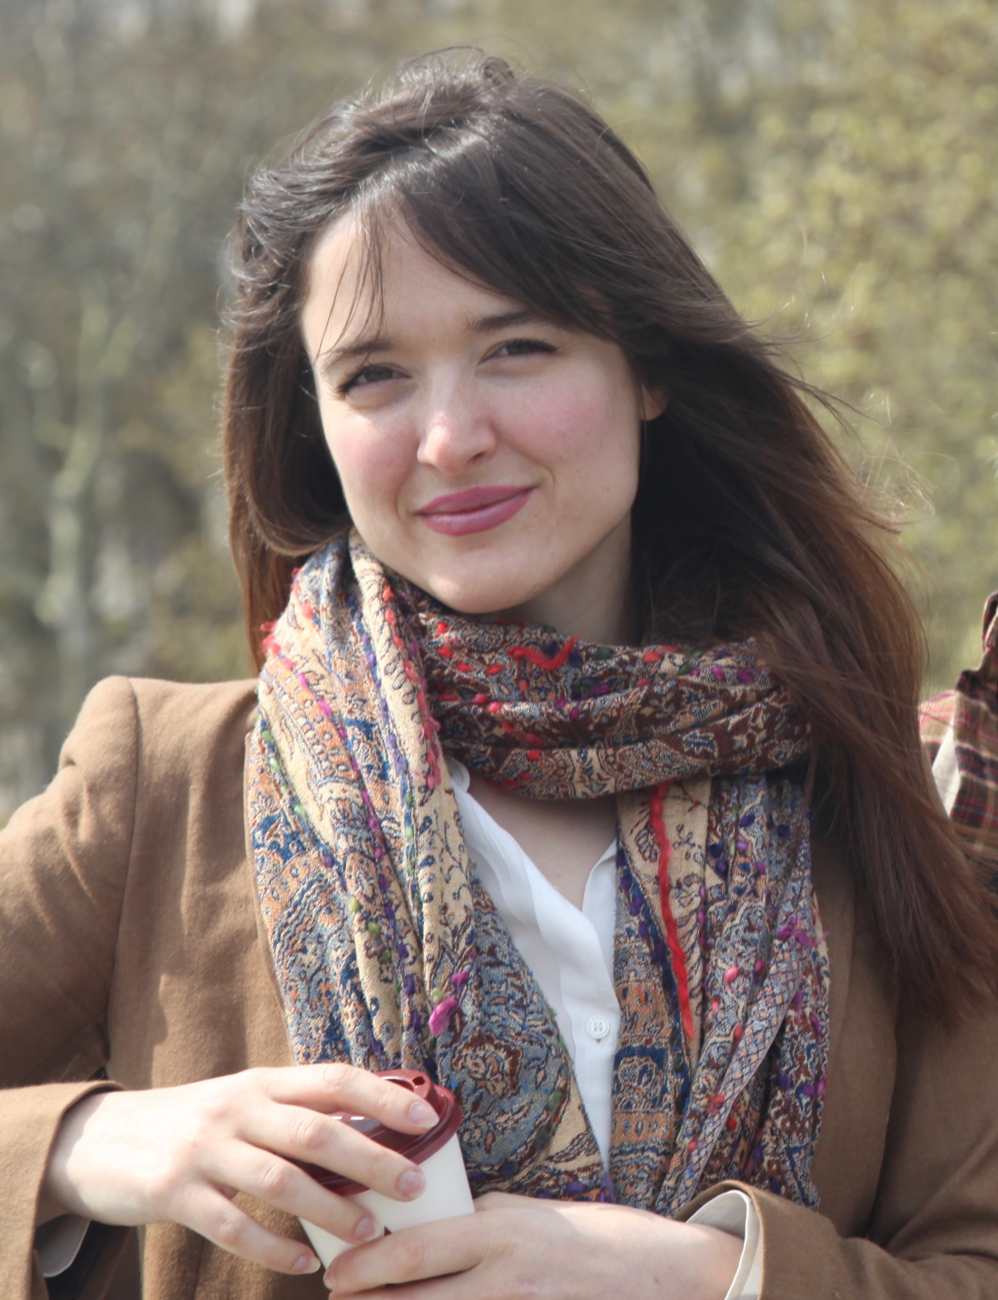
Faculty
Amanda Boetzkes (Professor)
is a specialist in modern and contemporary art history and researches the intersection between the biological sciences and contemporary art, theory, and criticism.
Susan J. Douglas (Assistant Professor)
specializes in Latin American Art as well as contemporary visual
culture and communication.
Sally Hickson, (Associate Professor)
researches courtly culture, secular imagery, and the construction of gender and identity in early modern visual culture.
Dominic Marner (Associate Professor)
studies Medieval European Art and Architecture, Museum Studies, and Colonialism in Art.
Christina Smylitopoulos (Associate Professor)
specializes in British art and visual culture of the long eighteenth century. Her research explores graphic satire and book illustration.
Jessica Jacobson-Konefall (Assistant Professor CLA of Canadian Art and Theory). Her research focuses on Canadian and Indigenous contemporary art, eco art in Canada, care and vulnerability in the arts and critical theory.

Slide 5

MA by Course Work and Major Research Paper
In the course-work and major research paper option students must complete:
Three core courses
Three electives
A major research paper (MRP) of 10,000-15,000 words.
MA by Course Work and Thesis
In the thesis option, students must complete:
Three core courses and one elective.
One elective may be an approved course from another College of Arts program.
Students will also complete a thesis, consisting of an extensive piece of research of 30,000-35,000 words and an oral examination.
MA.AHVC
Programs

Slide 6
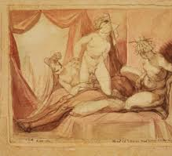
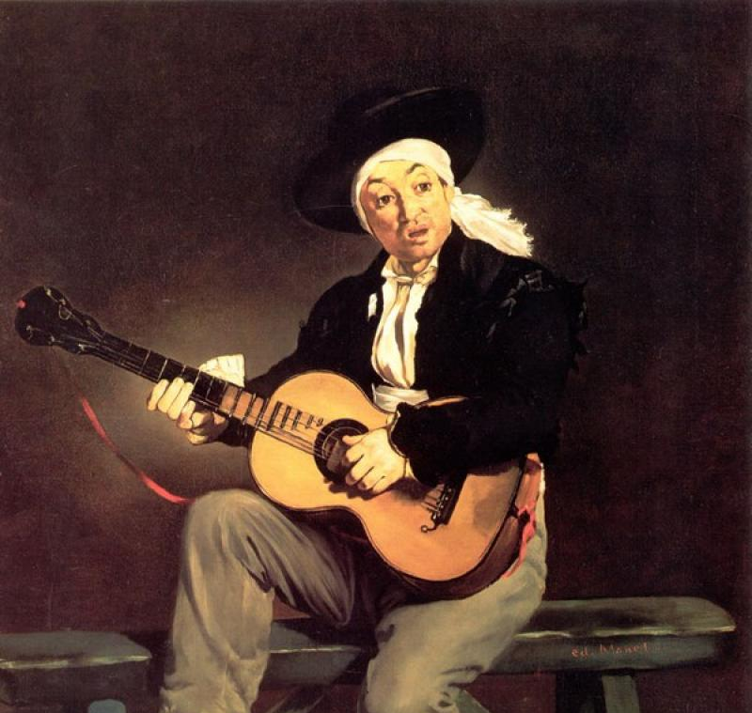
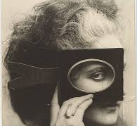
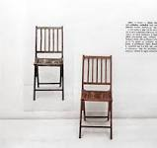
MA.AHVC
Research Projects
Constanza Salazar, Materialism to (Speculative) Realism: The Objects of Conceptual and Post-Conceptual Art (CORNELL, PHD)
Sarah Carter, Henry Fuseli and the Sexual Sublime (McGILL, PHD, MADOFF PRIZE WINNER/SSHRC)
Karly Boileau, Self-Fashioning and Autofiction in the Photographic Portraits of the Countess de Castiglione (IDEA EXCHANGE, CAMBRIDGE)
Vanja Stojanovich, The Kilnaruane High Cross: Iconography, Site, and Potential Pilgrimage Round in Bantry, County Cork (LIBRARY SCHOOL)
Breena Langevin, Canadian Missionary Churches: Religious Inculturation and the Visual Persistence of Aboriginal Culture (DIRECTOR OF A GALLERY)

Slide 7
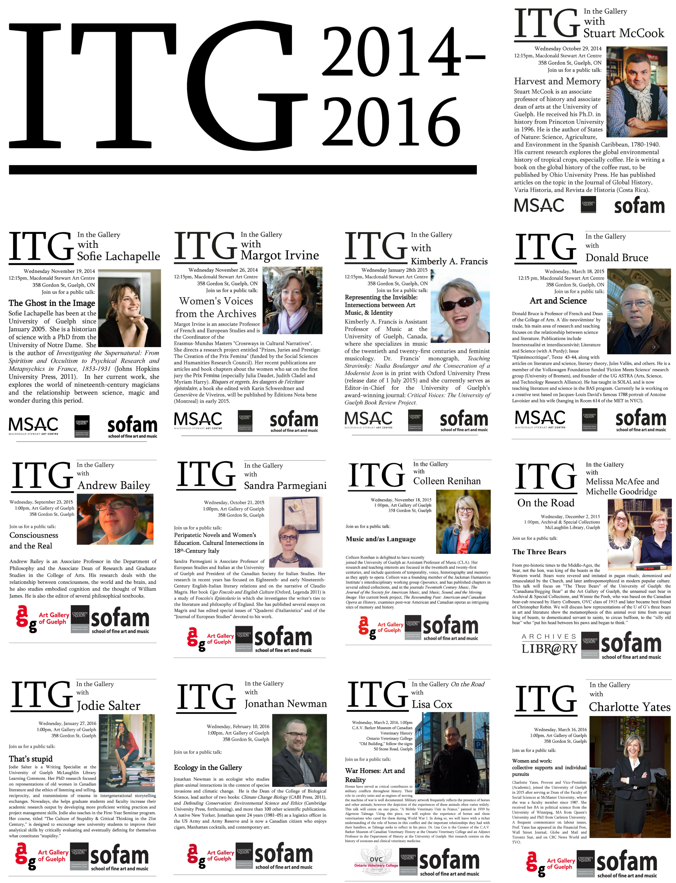
MA.AHVC
Events
ITG-In the Gallery
A series of lunch-time talks by scholars from varied disciplines to investigate their research interests in relation to a work of art. Normally hosted at the Art Gallery of Guelph, along with other collections on campus, the series has so far welcomed musicologists, librarians, literary theorists, a philosopher, two environmental scientists, a provost, and historians of science, an anthropologist, and a sociologist, to have an encounter with an object from a collection that is, in some way, related to their research.

Slide 8
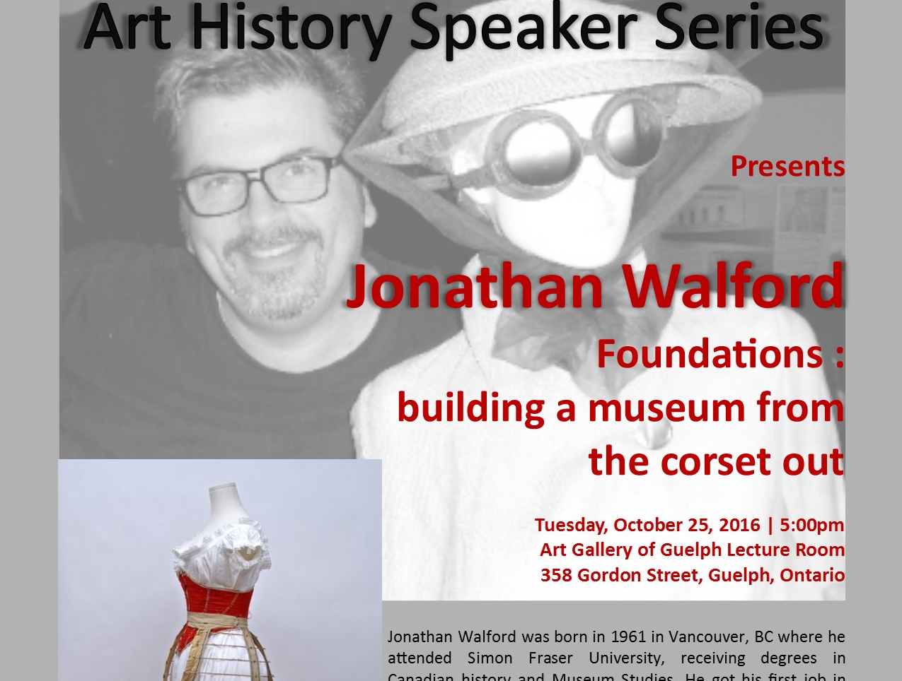

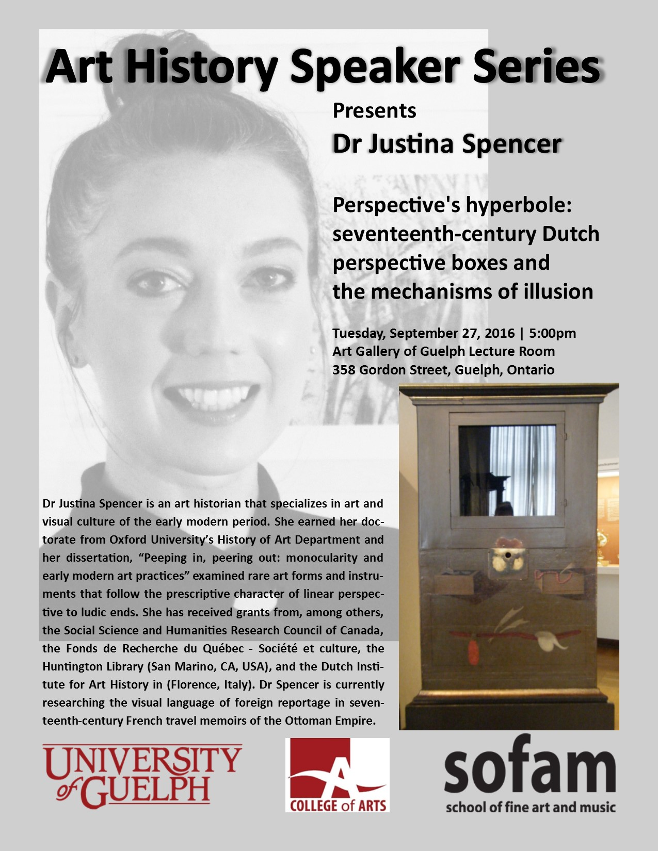
MA.AHVC
Events

Slide 9
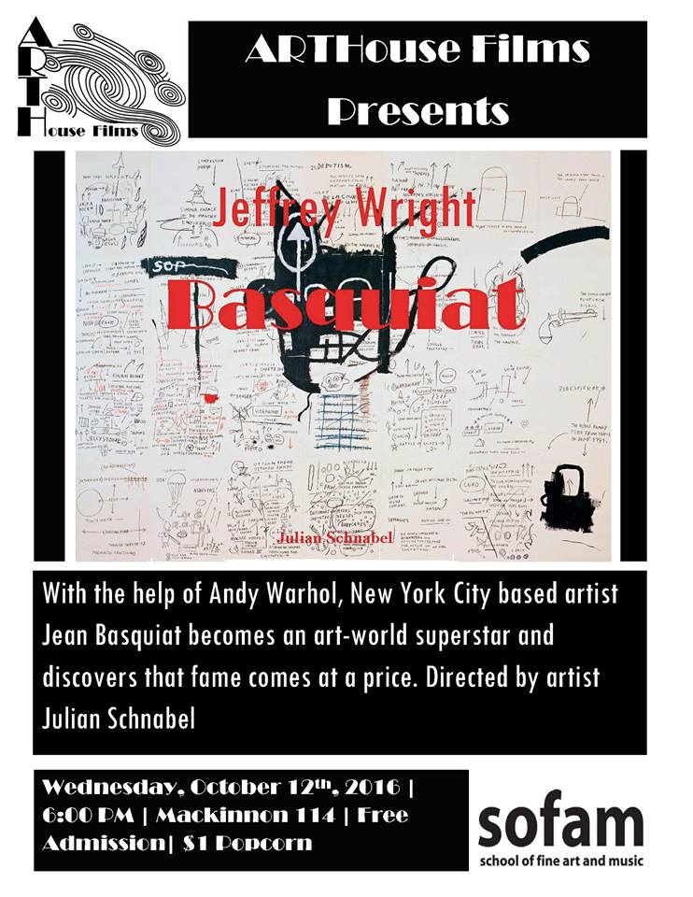

MA.AHVC
Events

Slide 10
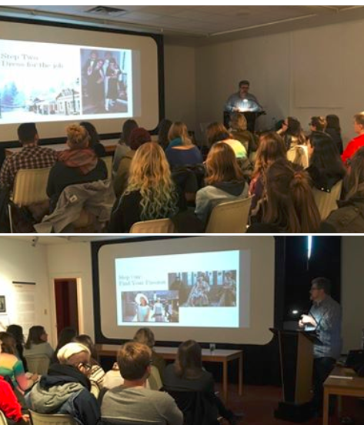
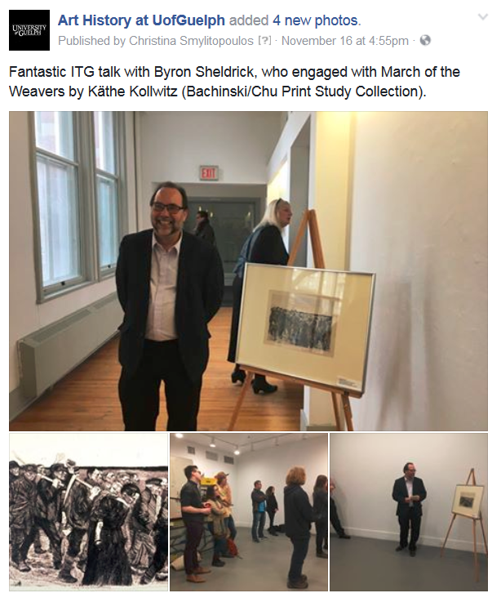
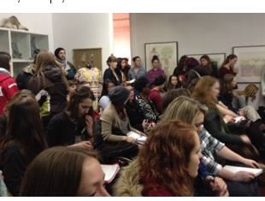
MA.AHVC
Events

Slide 11
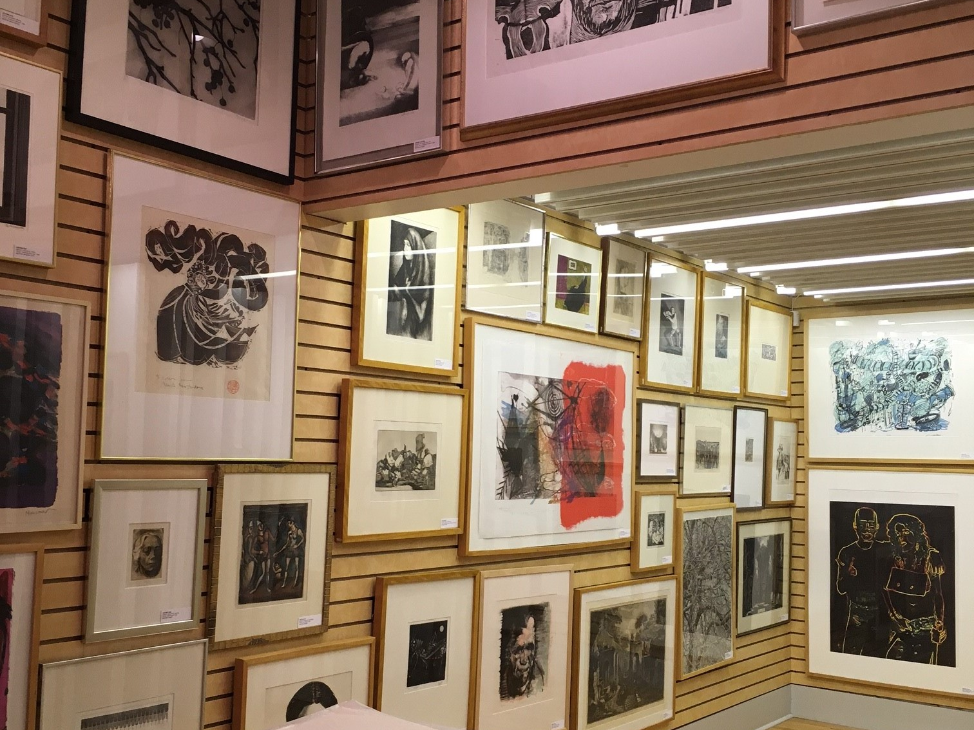

MA.AHVC
Opportunities

Slide 12
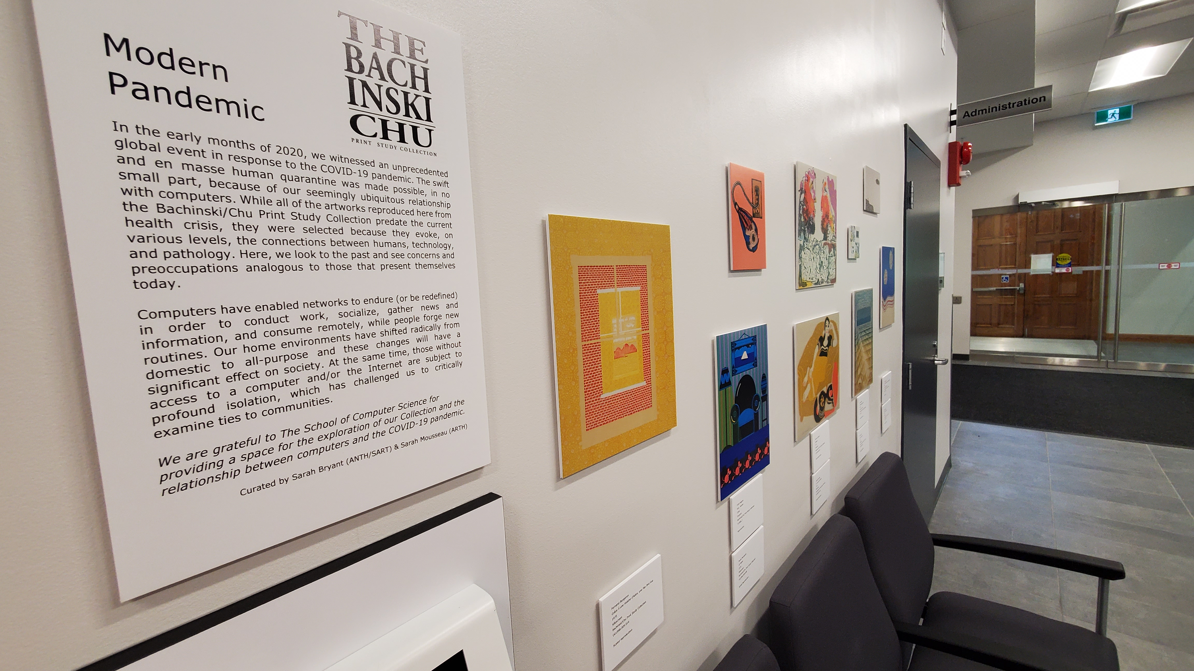
Opportunities
Curatorial Projects
Deep Research
Collections’ Management
Principles and Practices

Slide 13
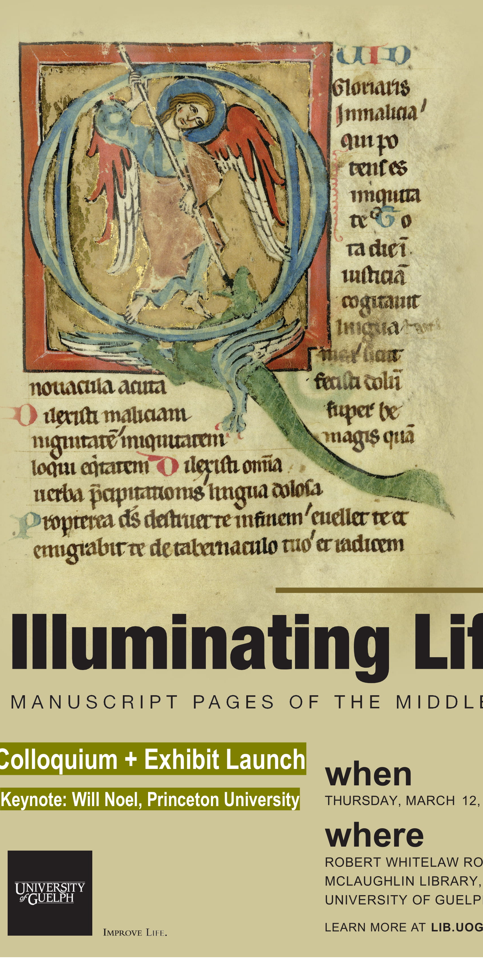
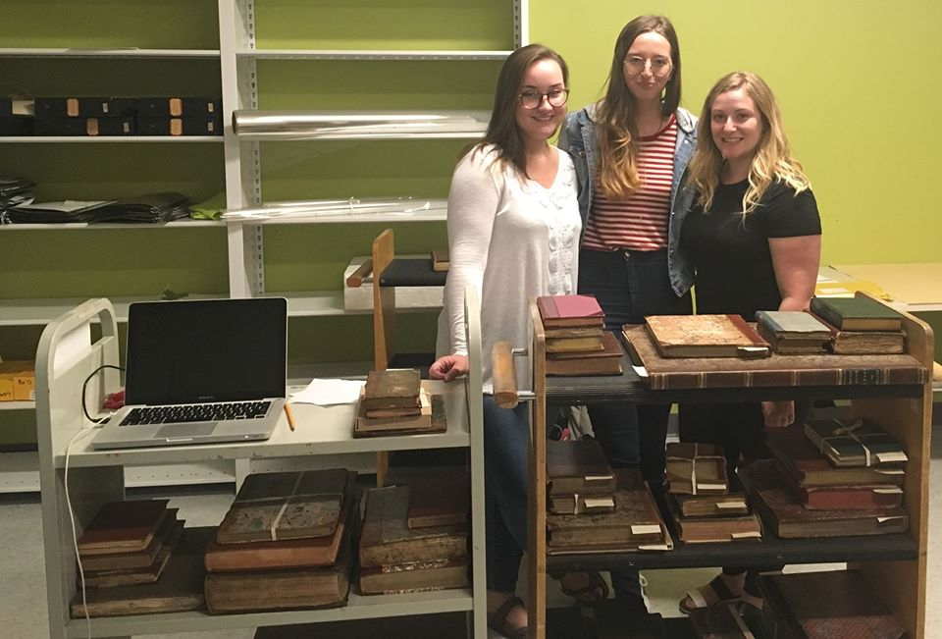
MA.AHVC
Opportunities

Slide 14
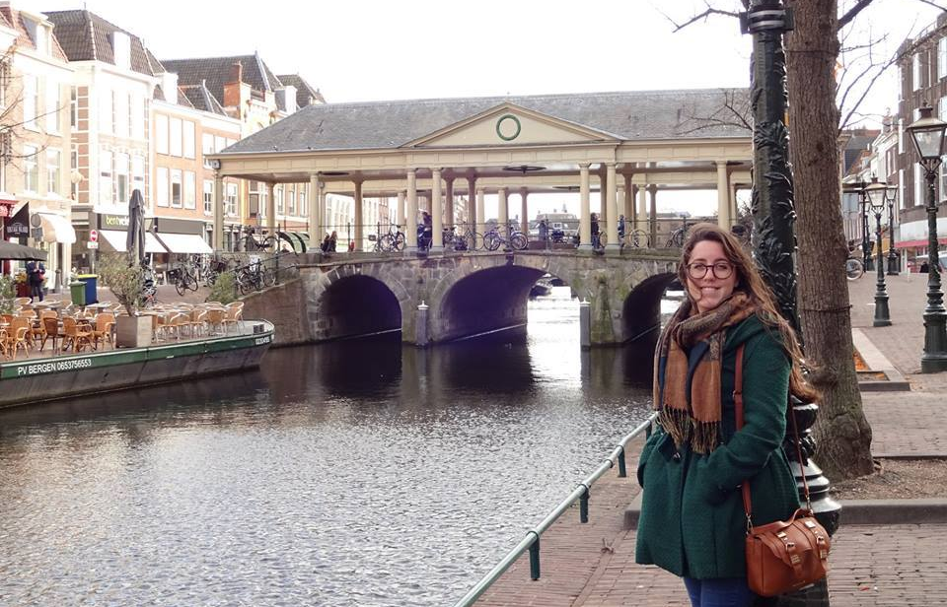
MA.AHVC
Opportunities

Slide 15
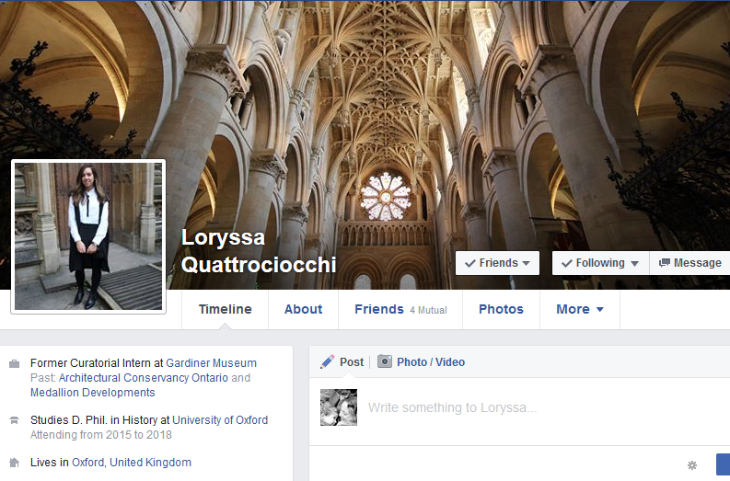
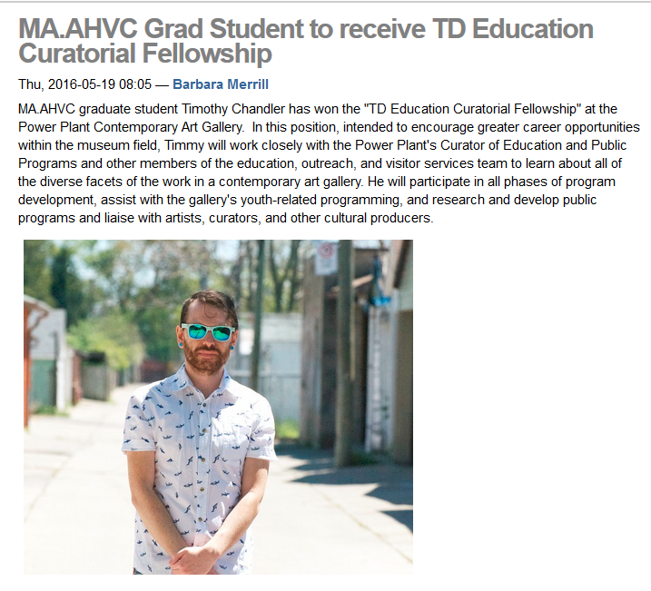
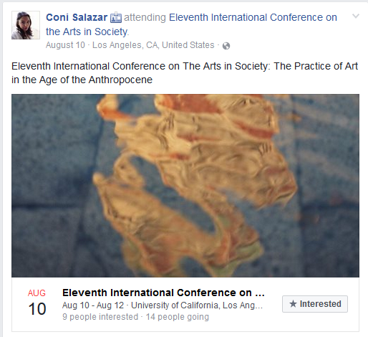
MA.AHVC
Opportunities

Slide 16
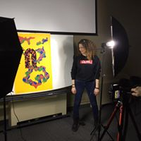
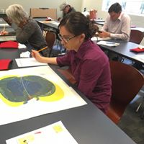
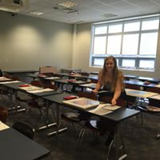
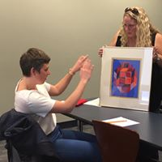
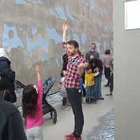
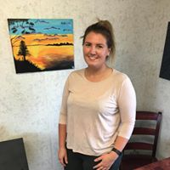
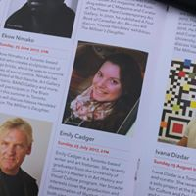
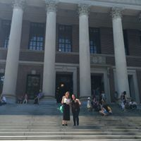
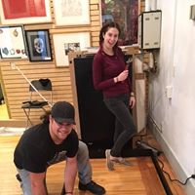
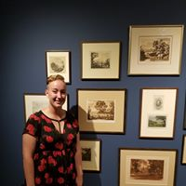
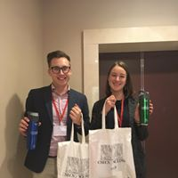
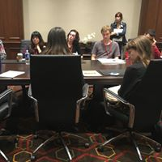
Community

Slide 17
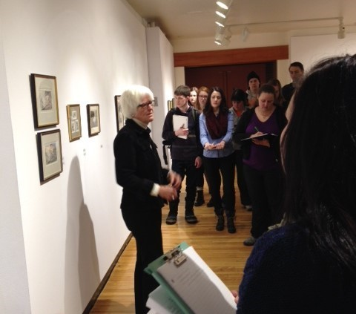
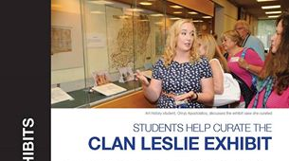
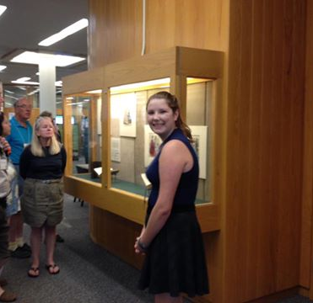
MA.AHVC
Community

Slide 18
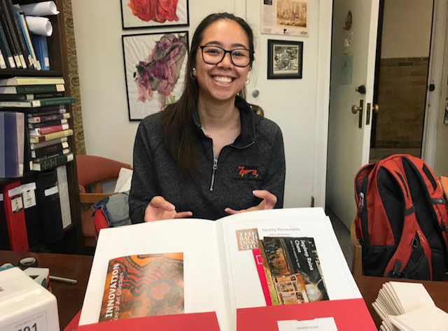
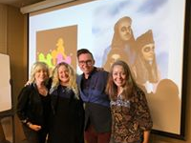
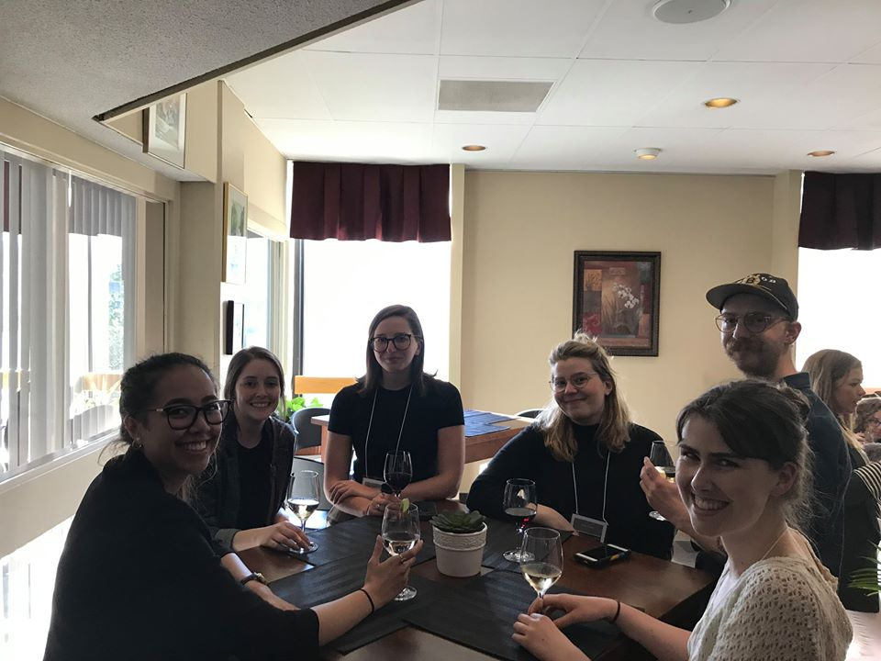
MA.AHVC
Community

Slide 19
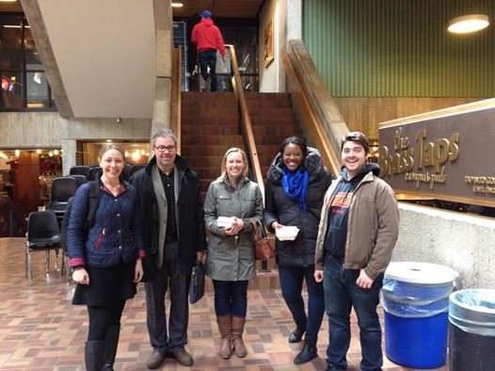
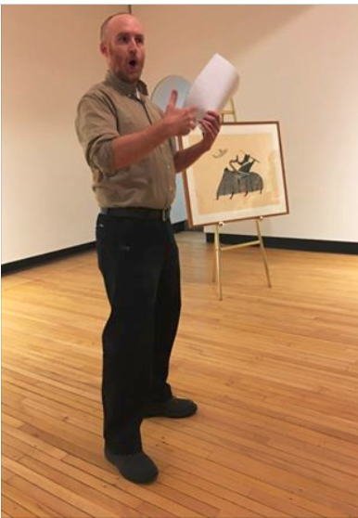
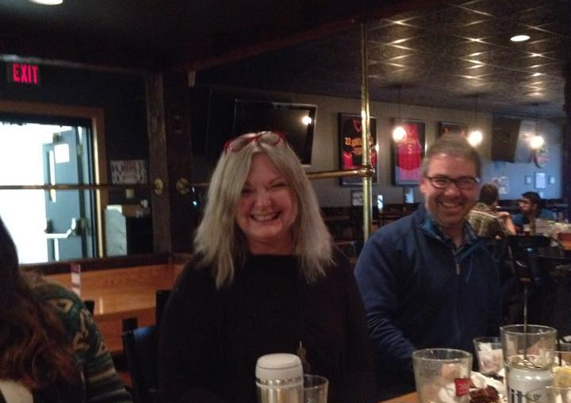
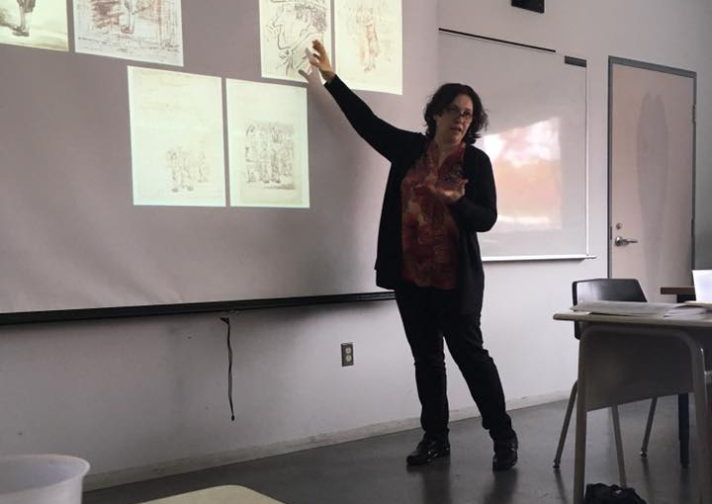
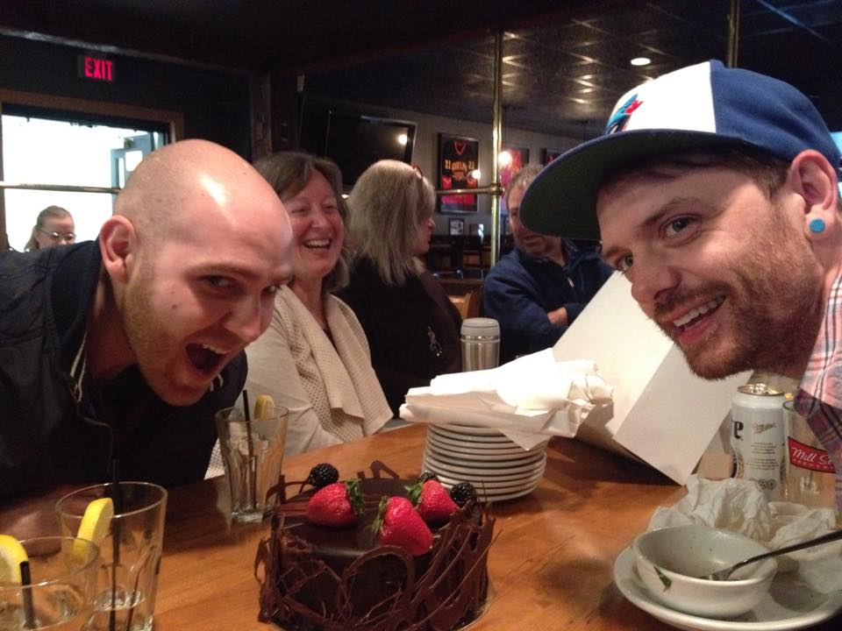
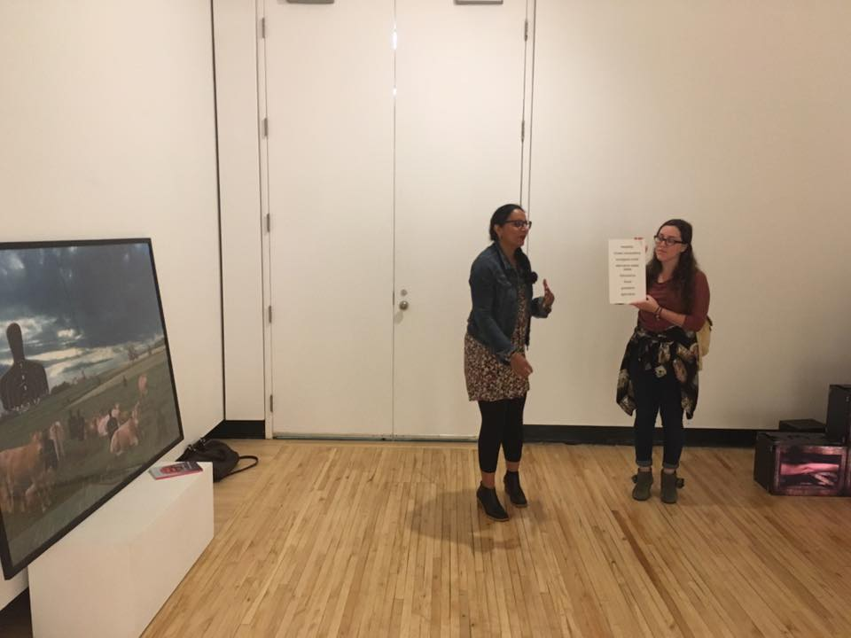
MA.AHVC
Community

Slide 20
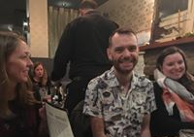
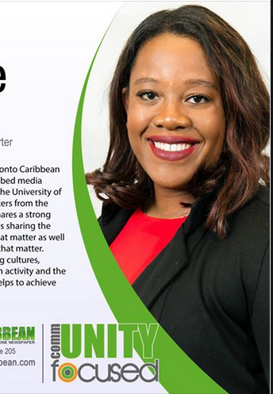
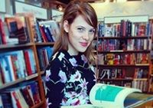



MA.AHVC
Community

Slide 21






MA.AHVC: Alumni
Peter Flannery: Curatorial and Collections Intern at the Canadian Clay and Glass Gallery in Waterloo; Caroline Hickey: Registrar and Head of Collections/Woodstock Art Gallery; Breena Langevin, Director of Chase Gallery, Montreal; Emily Cadger, PhD UBC; Sarah Carter, PhD McGill; Alexandra Hartstone, Curatorial Assistant, The Robert McLaughlin Gallery.

Slide 22

Alumnus:
Loryssa Quattrociocchi
City of Toronto –
Assistant Heritage Planner
The Ecclesiological Gothic Revival in Southwestern Ontario: Three Churches By Gordon W. Lloyd (1832-1905)

Slide 23
MA.AHVC
ADMISSION REQUIREMENTS
Admission to the MA program in Art History and Visual Culture may be granted on the recommendation of the School of Fine Art and Music to:
The holder of a BA degree (honours equivalent), or an honours BA (or its equivalent in art history) with a minimum of a 75% average; or in exceptional cases, the holder of a degree in another field who has completed a minimum of six one-semester courses in art history;
or a student who has satisfied the requirements for transfer from the provisional-student category.
It is highly recommended that applicants complete at least eight semesters of courses in art history, cultural studies, or related areas prior to applying. Serious interest in, and substantial familiarity with, historical and contemporary issues in Art History and Visual Culture is expected.

Slide 24

MA.AHVC
Application Supplementary Support Materials
Each applicant must submit the following:
A single-page statement that outlines the applicant's career objectives and reasons for wishing to study in the University of Guelph's Master of Arts program in Art History and Visual Culture.
Letters of reference from two professors. The applicant must have taken a significant proportion of course work from at least one of the professors. An acceptable alternative to one such letter may be from the department Chair on behalf of the department in which the applicant has studied, or from a professional in the field who is familiar with the applicant's abilities.
Un-Official University Transcripts
Writing Sample

Slide 25

MA.AHVC
FUNDING
If you accept an offer for a place in the MA.AHVC, we will recommend to the Office of Graduate Studies to provide a commitment of financial assistance. Provided your progress in the MA program remains satisfactory, this is what you will receive over your two-year program:
Sample offer THESIS-STREAM (5 Semester Program):
2 Graduate Teaching Assistantship (GTA) and 1 Graduate Service Assistantship (GSA). The most recent salary for these positions is $5,925 per GTA/GSA, making the total GTA amount $17,775
A University Graduate Scholarship, in the amount of $7,200, which will be paid in equal installments for each of the semesters you are registered.
The total funding will amount to $24,975
Sample offer MRP-STREAM (3 Semester Program):
1 Graduate Teaching Assistantship (GTA) and 1 Graduate Service Assistantship (GSA). The most recent salary for these positions is $5,925 per GTA/GSA, making the total GTA amount $11,850
A University Graduate Scholarship, in the amount of $5,400, which will be paid in equal installments for each of the semesters you are registered.
The total funding will amount to $17,250

Slide 26
FUNDING
Our MA students regularly receive funding from the College of Arts for research travel. They have used this money to travel to:
*Ireland
*New York
*Winnipeg
*Scotland
As well, they receive funding for conferences all over Canada.

Slide 27





MA.AHVC
Travel/Research Funding:
*Ireland *Hungary
*New York *France
*Winnipeg *Chicago
*Scotland *Boston
*Montreal *New Haven

Slide 28
Grants
As a potential graduate student, you can apply for government grants that are awarded on a competitive basis:
OGS – Ontario Graduate Scholarship
SSHRC – Social Sciences and Humanities Research Council

Slide 29
OGS – Ontario Graduate Scholarship https://www.uoguelph.ca/graduatestudies/current/funding/scholarships/gov-fundedawards/ogs
OGS are designed to encourage excellence in graduate studies at the Master’s and Doctoral levels
Jointly funded by the Ontario Government and the University of Guelph
Maximum of $15,000 annually ($5000 each semester)
If entering the first or second year of graduate studies at the time of application you must have an overall average of at least A-, or the equivalent, on the last 20 one-term/semester courses, or the equivalent, completed.

Slide 30
SSHRC- CGS-M Program
The CGS M Program provides financial support to high-calibre scholars who are engaged in eligible master’s or, in some cases, doctoral programs in Canada (refer to Eligibility). This support allows these scholars to fully concentrate on their studies in their chosen fields.
Eligibility: Students must be enrolled in, have applied for, or will apply for full-time admission to an eligible graduate program at the master’s or doctoral level at a Canadian institution with a CGS M allocation. Note: Applicants who are not currently enrolled in their intended graduate program must submit an application for admission by the deadline for their intended graduate program or by March 15, whichever comes first;
And must have achieved a first-class average, as determined by the host institution, in each of the last two completed years of study (full-time equivalent)

Slide 31
SSHRC- CGS-M Program
Value: $17,500 for 12 months
Application procedures:
http://www.nserc-crsng.gc.ca/Students-Etudiants/PG-CS/CGSM-BESCM_eng.asp

Slide 32
How SSHRC applications are evaluated
Academic Excellence Weighting: 60% | Academic excellence—as demonstrated by academic transcripts, awards and distinctions.
Research Potential Weighting: 30% | Quality of analytical skills, ability to think critically, ability to apply skills and knowledge, judgment, originality, initiative and autonomy, determination, and ability to complete projects within an appropriate period of time—as demonstrated in the description of the degree program and by work experience, research contributions, letters of appraisal and, if applicable, the departmental appraisal.
Communication Skills Weighting: 10% | As demonstrated in the description of the degree program and, if relevant, by work experience, community involvement and other extracurricular activities, as well as by letters of appraisal, the quality of presentation of the application and, if applicable, the departmental appraisal.

Slide 33

MA.AHVC
Please contact the Graduate Program Assistant
Barbara Merrill
bmerrill@uoguelph.ca

Slide 34
U of G Virtual Graduate Preview Week 2020
Thank you for joining us!
Art History and Visual Culture
College of Arts
Presenters:
Dominic Marner – Graduate Program Coordinator, dmarner@uoguelph.ca
Loryssa Quattrociocchi – Alumnus
Barb Merrill – Producer/Moderator
Website: https://www.uoguelph.ca/arts/sofam/ma-arthistory

