Slide 1
WannaCrypt Ransomeware Customer Guidance
Microsoft

Slide 2
Overview of WannaCrypt
A large Ransomware campaign across the world
Attack is using a vulnerability fixed in March 2017 Security Update (MS17-010, SMBv1)
Microsoft recommends:
Confirm the install of the security update on all systems
Ensure anti-malware products are up-to-date
Disable SMBv1 if the security update cannot be installed immediately
Reference: Microsoft Security Response Center Blog
Customer Guidance for WannaCrypt Attacks
https://blogs.technet.microsoft.com/msrc/2017/05/12/customer-guidance-for-wannacrypt-attacks/

Slide 3
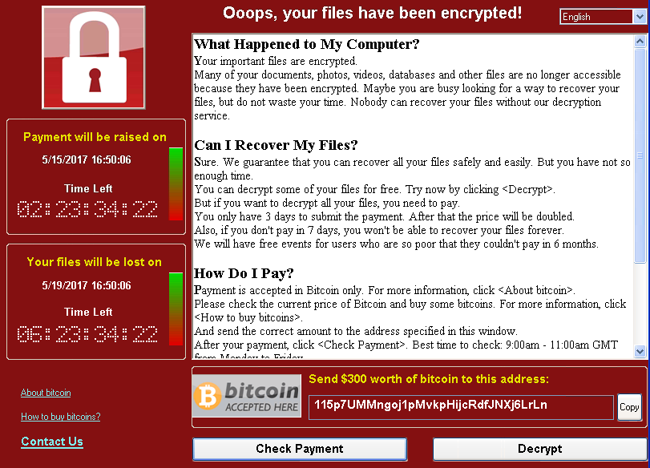
What WannaCrypt does
Infect
Runs Attack if MS17-010 is not installed [ETERNALBLUE]
Encrypt
Encrypts 179 file types
Spread
Scans the local LAN and wider internet for port 445
Installs Trojan if attack is successful [DOUBLEPULSAR]
Attempt to infect on open ports
Shows the message and demand for payment using bitcoin.

Slide 4
Affected Environment
All Windows version
Office 365 and Azure
We are continually monitoring and updating to protect against these kinds of threats including Ransom:Win32/WannaCrypt.​
PaaS VMs are updated by Microsoft and includes recent security patches
https://docs.microsoft.com/en-us/azure/cloud-services/cloud-services-guestos-msrc-releases

Slide 5
Recommended Actions - Prevention
(1) Keep systems up-to-date
Ensure Microsoft Security Bulletin MS17-010 Security Update for Microsoft Windows SMB Server is installed
Supported versions Windows
Windows Vista, Windows Server 2008, Windows 7, Windows Server 2008 R2, Windows 8.1, Windows Server 2012, Windows 10, Windows Server 2012 R2, Windows Server 2016
Security Update MS17-010 has been published in March
Out of Support Products
Windows XP SP3, Windows 8, and Windows Server 2003 SP2
Download the security update from Windows Update

Slide 6
Recommended Actions - Prevention
If one of these updates is installed on the system, the system is protected.
the vulnerability was fixed in March 2017 Security update. March, April and May rollup also includes all previous updates including March security update)
OS | 2017 Mar (Security Only) | 2017 Mar (Monthly Quality) | 2017 Apr (Monthly Quality) | 2017 May (Monthly Quality) | Independent Update
Windows XP / Windows Server 2003 / Windows 8 | NA | NA | NA | NA | KB4012598
Windows Vista / Windows Server 2008 | NA | NA | NA | NA | KB4012598
Windows 7 / Windows Server 2008 R2 | KB4012212 | KB4012215 | KB4015549 | KB4019264 | NA
Windows Server 2012 | KB4012214 | KB4012217 | KB4015551 | KB4019216 | NA
Windows 8.1 / Windows Server 2012 R2 | KB4012213 | KB4012216 | KB4015550 | KB4019215 | NA
Windows 10 1507 / Windows 10 LTSB 2015 | NA | KB4012606 | KB4015221 | KB4019474 | NA
Windows 10 1511 | NA | KB4013198 | KB4015219 | KB4019473 | NA
Windows 10 1607 / Windows 10 LTSB 2016 / Windows Server 2016 | NA | KB4015438 | KB4015217 | KB4019472 | NA

Slide 7
Link to Windows Update (out-of-support products)
Download English language security updates: Windows Server 2003 SP2 x64, Windows Server 2003 SP2 x86,Windows XP SP2 x64, Windows XP SP3 x86, Windows XP Embedded SP3 x86, Windows 8 x86,Windows 8 x64
Download localized versions for the security update for Windows XP, Windows 8 or Windows Server: http://www.catalog.update.microsoft.com/Search.aspx?q=KB4012598

Slide 8
Recommended Actions - Prevention
How can I find out if the Security Update is installed or not?
You can run the script to find if necessary update has been installed or not.
Script wmic qfe list | find "KBnumber“
(Example )Windows 8.1 / Windows Server 2012 R2 wmic qfe list | find "KB4012213" wmic qfe list | find "KB4012216" wmic qfe list | find "KB4015550" wmic qfe list | find "KB4019215" Output http://support.microsoft.com/?kbid=4015550 TESTPC01 Security Update KB4015550 NT AUTHORITY\SYSTEM 4/12/2017

Slide 9
Recommended Actions - Prevention
(2) Keep the Anti-malware signature is up-to-date.
Windows Defender, System Center Endpoint Protection, and Forefront Endpoint Protection detect this threat family as Ransom:Win32/WannaCrypt.
In addition, the free Microsoft Safety Scanner http://www.microsoft.com/security/scanner/ is designed to detect this threat as well as many others.

Slide 10
Recommended Actions - Prevention
(3) Implement mitigation (if security update cannot be installed immediately)
Disable SMBv1
Windows Vista and later
See Microsoft Knowledge Base Article 2696547
Windows 8.1 or Windows Server 2012 R2 and later
For client operating systems:
Open Control Panel, click Programs, and then click Turn Windows features on or off.
In the Windows Features window, clear the SMB1.0/CIFS File Sharing Support checkbox, and then click OK to close the window.
Restart the system.
For server operating systems:
Open Server Manager and then click the Manage menu and select Remove Roles and Features.
In the Features window, clear the SMB1.0/CIFS File Sharing Support check box, and then click OK to close the window.
Restart the system.

Slide 11
Recommended Actions - Prevention
Impact of mitigation
The SMBv1 protocol will be disabled on the target system. SMB1 is very old technology. Some legacy system that rely only on SMB1 will be impacted.
See more at
https://blogs.technet.microsoft.com/filecab/2016/09/16/stop-using-smb1/
https://blogs.technet.microsoft.com/josebda/2015/04/21/the-deprecation-of-smb1-you-should-be-planning-to-get-rid-of-this-old-smb-dialect/
How to undo the workaround
Retrace the workaround steps, and select the SMB1.0/CIFS File Sharing Support check box to restore the SMB1.0/CIFS File Sharing Support feature to an active state.

Slide 12
Recommended Actions - If affected
Call Microsoft Support.
Customers who believe they are affected can contact Customer Service and Support by using any method found at this location: https://support.microsoft.com/gp/contactus81?Audience=Commercial.
Clean up your machine and Recover the system.
Please see the steps in the following articles.
https://blogs.technet.microsoft.com/mmpc/2016/05/18/the-5ws-and-1h-of-ransomware/
https://www.microsoft.com/en-us/security/portal/mmpc/shared/ransomware.aspx
Submit New Sample.
If you feel you have detected a new threat, sample, please retrieve a sample of the malware and send it to the Microsoft Malware Protection Team https://www.microsoft.com/en-us/security/portal/submission/submit.aspx

Slide 13
Timeline of related events
Aug. 2016 | Shadow Broker emerged. Auctions NSA Attacks Claim to hack Equation Group, author of Stuxnet & Flame Auction includes weaponizable codes with 0-day exploits & trojans
Sep. 2016 | Microsoft released blog to encourage users to stop using SMB1 https://blogs.technet.microsoft.com/filecab/2016/09/16/stop-using-smb1/
Mar. 2017 | Microsoft released the Security Update for MS17-010 to fix SMB1 vulnerability
Apr. 2017 | Shadow Broker Releases throve of NSA Attacks Includes exploits against SMB (Eternal Blue) and Trojan Code (Double Pulsar) Microsoft releases advisory that no new vulnerabilities in SB release
May. 2017 | WannaCrypt complain has begun Attacker (unknown) turns NSA attack codes with Ransomware Payload, demands USD300-600 ransom
May. 2017 | Microsoft released the customer guidance and the security update for out-of-support products (Windows XP, Windows 8 & Server 2003)

Slide 14
Resources
Microsoft Guidance for WannaCrypt https://blogs.technet.microsoft.com/msrc/2017/05/12/customer-guidance-for-wannacrypt-attacks/
Microsoft Malware Prevention Center Technical Details about the ransomware worm https://blogs.technet.microsoft.com/mmpc/2017/05/12/wannacrypt-ransomware-worm-targets-out-of-date-systems/
MS17-010 Update Catalogue http://www.catalog.update.microsoft.com/Search.aspx?q=KB4012598

Slide 15
FAQs
Q. Is Windows XP Embedded affected?
A. there is a vulnerability in XP Embedded and security update is available.
Q. Is Windows Phone affected?
A. No. Windows Phone is not affected
Q. Can we distribute the security update for out-of-support using WSUS/SCCM?
A. Yes. You can manually download the security update and sync with WSUS/SCCM.
Please see more at: https://technet.microsoft.com/en-us/library/bb680473.aspx
Q. Any security update for Windows Server 2003 RTM, SP1?
A. We only offer the security updates for latest SP. For Windows Server 2003, we only offer update for Windows Server 2003 SP2.

