Slide 1
Spring Academic Open House
School of Computer Science
May 2020

Slide 2
Welcome
Welcome to the School of Computer Science (SoCS) at University of Guelph.
Dr. Minglun Gong:
May 2019 – Pres.: Director of SoCS
2016 – 2019: Head, Dept. of CS, Memorial Univ.
2007 – 2019: Associate Prof./Prof., Memorial Univ.
2006 – 2018: Adjunct Prof., Univ. of Alberta
2004 – 2007: Assistant Prof., Laurentian Univ.
1999 – 2000: Sessional Lecturer, Univ. of Saskatchewan
Notes:
Thank you for visiting us online. It is my pleasure to introduce the School of Computer Science (SoCS) on behalf of Dr. Minglun Gong, who has served as the Director since May 2019. Before coming to Guelph, he was Head of the Computer Science Department at Memorial University, in Newfoundland. His previous teaching experiences were at Memorial University, Laurentian University, University of Alberta, & University of Saskatchewan.

Slide 3
Long Tradition
Founded in 1971, SoCS will celebrate its 50th anniversary next year.
Maintained its focus on undergraduate education:
To develop strong technical and analytical skills in our students using hands-on experience in leading edge technology.
Notes:
The School of Computer Science was founded in 1971. The School will be celebrating our 50th anniversary in Spring of 2021.
Throughout its history, the School of Computer Science has maintained its focus on undergraduate education and providing opportunities for students.
Our mandate is to develop strong technical and analytical skills in our students using hands-on experience in leading edge technology.

Slide 4
Focus on Undergraduate Education
Policies for ensuring undergrad learning experiences:
Candidates for our faculty positions are required to teach mock lectures during interviews.
Teacher Assistants are also interviewed before being hired.
Experienced academic counselors:
Dr. Greg Klotz & April Nejedly
Notes:
There are several policies in place for ensuring the best undergrad learning experiences. For example, we require all candidates for our faculty positions to deliver sample lectures during their interviews, so that we can evaluate their teaching skills. We also interview all teaching assistants before they are hired.
Our two Academic Counselors Dr. Greg Klotz and April Nejedly, provide excellent support and experience to our undergraduate students.
Please look for their presentations for further information about our programs.

Slide 5
Award-Winning Faculty Members
Recent awards:
Dr. Dan Gillis:
2019 OCUFA Teaching Award
Only 4 professors from all Ontario universities received this prestigious award in 2019.
Dr. Gary Grewal:
2018 UgFA Distinguished Professor Award for Excellence in Teaching
Only 2 professors from all units in Univ. of Guelph were awarded in 2018.
Notes:
We our proud of our dedicated and caring faculty. Two of the School’s faculty members, Dr. Dan Gillis and Dr. Gary Grewal, were recently recognized for their passion and dedication to teaching our students.
Dr. Dan Gillis received the Ontario Confederation of University Faculty Associations (OCUFA) teaching award in October 2019.
Only four professors from Ontario universities received this prestigious award in 2019.
Dr. Gary Grewal received the University of Guelph Faculty Association (UGFA) Distinguished Professor Award for Excellence in Teaching.
Only two professors from across the University received this honour in 2018.

Slide 6
Dedicated and Award-Winning Co-op Coordinators
Students in our co-op programs are supported by Cooperative Education and Career Services.
Ms. Laura Gatto & Ms. Kate McRoberts, Co-op Coordinators for BComp Programs
Ms. Laura Gatto: 2019 Innovative Leadership Recognition Award
Recognized for the guidance and coaching she provided for SoCS students as a co-op coordinator.
Notes:
The School of Computer Science has two Bachelor of Computing cooperative education programs which are supported by the office of Cooperative Education and Career Services.
We are very fortunate to have two co-op coordinators, Ms. Laura Gatto & Ms. Kate McRoberts.
Ms. Gatto received the University of Guelph’s Innovative Leadership Recognition Award in 2019 in recognition of the guidance & coaching she provides to the School of Computer Science co-op students.

Slide 7
Active Student Society and Clubs
SoCIS, GWiCS, GCC, & Google DSC:
Run community building events.
Host tech and industry talks.
Run study & mentoring sessions.
Organize one of the largest College Royal events, Roboticon.
Notes:
If you like clubs and want to get engaged with other students, the School of Computer Science has it all.
Society of Computing & Information Science (SOCIS) is a student run club and represents the students at large. This club has executive positions that are elected each year by you the students.
One of our popular clubs for female students is the Guelph Women in Computer Science Club otherwise known as GWiCS.
There also clubs that are dedicated to helping students expand their technical expertise outside of classes, including the Guelph Coding Community (GCC) and the Google Developers Student Club.
These clubs run community building events, host tech talks, study & mentoring sessions, and organize one of the largest College Royal events, Roboticon in March.

Slide 8
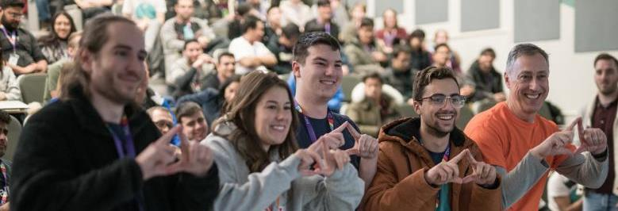
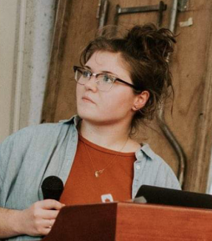
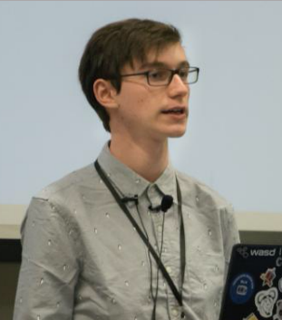
Award-Winning Students for Engagement & Leadership
M. Asch, L. Elliott, D. Miller, & L. Giancola:
2019 Transforming Tomorrow Challenge
M. Gabriel & K. Rourke:
2019 Co-op Student Awards
M. Asch (GCC exec):
2019 Student Experience Award
Notes:
Featured in these photos are some of our great students. Below are a few examples of students who were recognized for their engagement & leadership.
Marshall Asch, Lindsay Elliott, Devon Miller, & Lucas Giancola won the Transforming Tomorrow Challenge, a hackathon host by McMaster University in January 2019.
Madeline Gabriel & Keefer Rourke won Co-op Student Awards in 2019 for their outstanding performance during co-op internships and for supporting other students in their pursuit of co-op placements.
Marshall Asch won the 2019 Student Experience Award for his role in managing the Guelph Coding Community, facilitating activities with our undergraduate and graduate students, and co-leading the development of an environmental and health monitoring tool used in the Innuit community of Rigolet, Nunavut.

Slide 9
Exciting New Changes
SoCS also embraced exciting changes in recent years.
Its historical home (Reynolds Building) received major renovation and reopened in August 2018.
Notes:
In August 2018, the School of Computer Science moved back into our historical home, the Reynolds Building, after major renovations had been done to modernize and transform our work and teaching spaces.
During these renovations we improved our long tradition of our focus on undergraduate education by providing resources and allocated state of the art equipment and facilities.
In the photos show are the main entrance to Reynolds, our multimedia classroom used for seminars and group meetings, a graduate student lab, and an undergrad student lab.

Slide 10
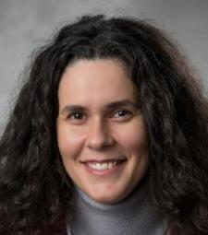
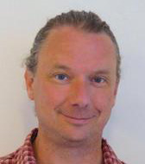
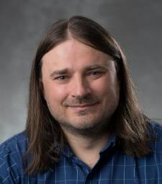
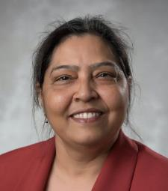
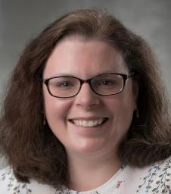
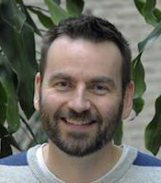
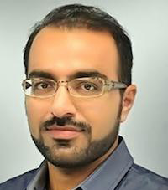
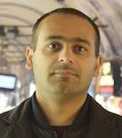
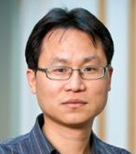
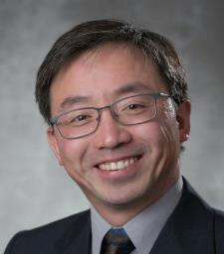
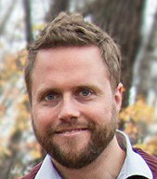
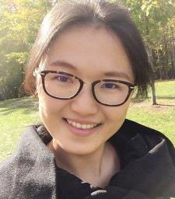
New Faculty Members
It welcomed 12 new faculty members in the past 4 years.
Brought state-of-the-art research expertise in:
Machine learning
Human-computer interaction
Cybersecurity
Mobile computing
Computer vision
Computer graphics
Notes:
Over the past four years, we have welcomed 12 new faculty members to the School of Computer Science.
These experts bring to our School diversity and state-of-the-art research expertise in areas such as machine learning, Human-Computer interaction, cybersecurity, mobile computing, computer vision, and computer graphics.

Slide 11
Increasing Strong Research Profiles
Not well-known for its research capacity in the past.
Research reputation has dramatically improved.
Currently ranked at 12 among 24 Canadian universities on CSrankings.org.
Tie with Queens, Manitoba, & Ottawa.
Higher than Ryerson, McMaster, Western…
Notes:
Even though the School of Computer Science has not historically been well-known for our research we have and are working towards top innovative research. You can see by this recent CSRankings our research reputation has dramatically improved.
Based on CSrankings.org, a well-recognized, metrics-based ranking of universities based on the amount of state-of-the-art research outcomes, Guelph is currently ranked at 12 among 24 Canadian Universities.
We are tied with the University of Queens, University of Manitoba, and University of Ottawa, while ranked higher than Ryerson University, McMaster University, and Western University.

Slide 12
Ranking in Selected Areas
Ranked at #5 in areas that SoCS has strong expertise:
Computer vision
Mobile computing
Algorithms & complexity
Computer graphics
Human-computer interaction
Notes:
Based on our strengths the School of Computer Science at the University of Guelph is ranked fifth on the CSRanking for Computer Science. These areas of strong expertise include computer vision, mobile computing, algorithms & complexity, computer graphics, and human-computer interaction.

Slide 13
Master of Cybersecurity and Threat Intelligence
A new professional master program was launched in Fall 2019.
Offers students the potential for a demanding and exciting career in cybersecurity, cyber threat intelligence, & digital forensics.
Connects students with leaders in the field through industry advisory board meetings and internship opportunities.
Notes:
In the Fall 2019 semester, a new professional Master’s program called Master of Cybersecurity and Threat Intelligence was launched. This one-year program offers students the potential for a demanding and exciting career in cybersecurity, cyber threat intelligence and digital forensics. This program connects the students with leaders in the field through industry advisory board meetings and internship opportunities.
Now that society is spending more time doing activities online and social distancing this program is expected to grow even further, as it meets a strong industry demand for professionals in cybersecurity and threat intelligence.

Slide 14
Attracts More & Stronger Students
The number of applicants has more than doubled in the past 4 years.
The acceptance ratio has dropped accordingly.
Notes:
With increased computer usage there is a higher student demand for computing education. The red curve in the figure shows the increasing number of high school students who applied to the School of Computer Science program over the last four years.
With this increase in enrolment this has made our Computer Science programs competitive amongst other Universities as shown in our 5th placed ranking on the CSRankings for Computer Science.
Thus, you will be surrounded by equally bright and talented students in your classes.

Slide 15
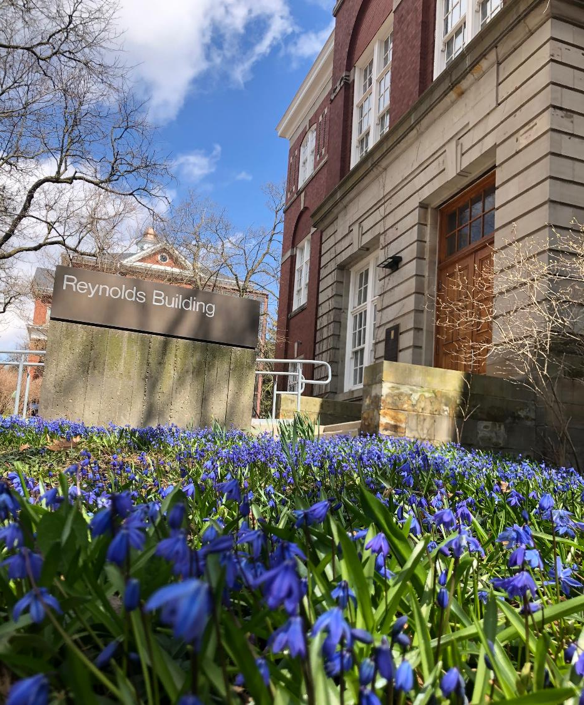
Notes:
Thank you for visiting us, we hope to see you soon in the School of Computer Science program on our beautiful University of Guelph campus.
If you have any questions, please feel free to engage with our academic counselors, student and faculty volunteers.

