Slide 1

CentreSuite – User Guide
Card program

Slide 2
Table of Content
Introduction
CentreSuite: Sign-on page
CentreSuite: Creating and Printing Expense reports
Keep Expense Report and Original Receipts
Summary of Monthly Submission of Expense Report
Escalate and Audit procedure
Seeking professional help
Appendix A – Home Page
Appendix B – Statements & Review Account Activity
Appendix C – Uploading Receipts using Mobile Device
Appendix D – Tax coding
Appendix E – Forms

Slide 3
Introduction
Web based application used for expense management and approval on a monthly basis
Link to CentreSuite: https://www.centresuite.com/centre?Scotiabank2280
All expenses must be allocated to right GL, tax and submitted to approvers by 24th with supporting documents receipts uploaded --- There is an email reminder sent to users on 21st of each month.
A P-card cycle timeline
Finish reconcile and submit for approval
Book in Oracle and pay out
Transaction period: Reconcile on daily basis
21st
20th
24th
27th
Notes:
Scotia Bank P-card statement is from 21st of previous month to 20th of current month. Depends on the number of transactions your P-card have, you can code the transaction on weekly or monthly basis. Payment date is 27th.
The deadline for reconciliation to be completed is 24th. The “completed reconciliation” means 1. All the transactions are reviewed, receipts are loaded to each of the transactions; 2. Descriptions, GL string, Tax are selected based on the receipts; 3. Expense report is submitted and approved (in department control).

Slide 4
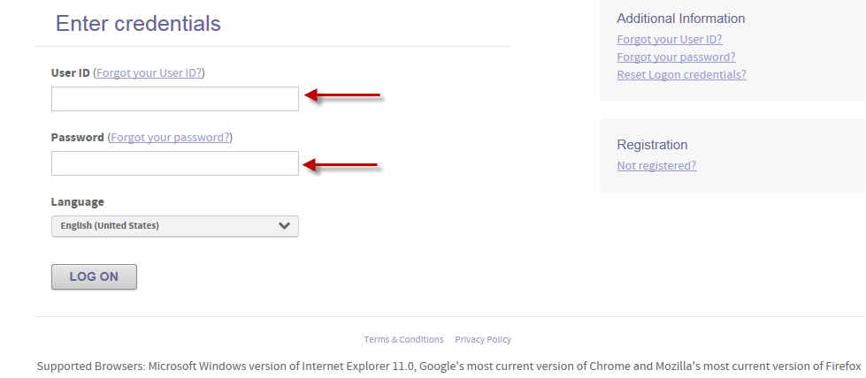
CentreSuite: Sign-on page
https://www.centresuite.com/centre?Scotiabank2280
This screen Allows you to:
Log-on to access your account
Reset or unlock your user ID
Send your password hint

Slide 5
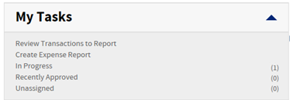
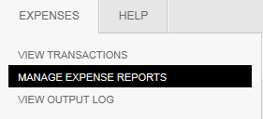
CentreSuite: Creating and Printing Expense reports
1. There are two ways to create an expense report from the Home Page:
  From the home page click on the “In Progress” link
  Select “Manage Expense Reports” from the Expenses drop down menu bar
a. Click on link
b. Select ‘Manage Expense Reports
2. Select the details button for the expense report that is automatically created for you

Slide 6
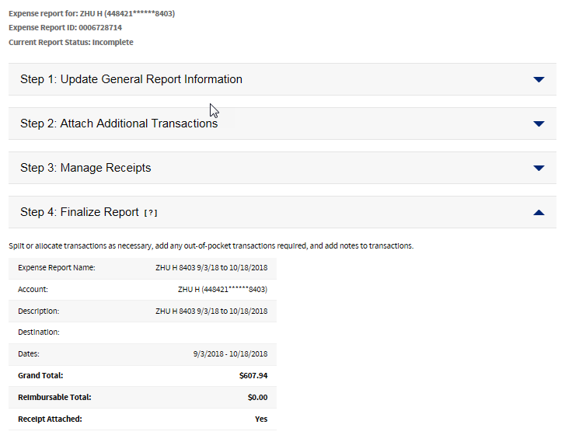
CentreSuite: Creating and Submitting Expense reports (continued)
3 a. This is where you review your Expense Report for the Cycle

Slide 7
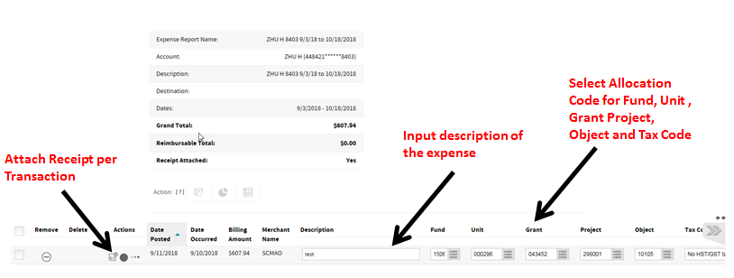
CentreSuite: Creating and Submitting Expense reports (continued)
3 b. This is also where you can allocate transactions
If you do not complete all mandatory fields and try to submit, you will receive an error and will have to make the necessary corrections.

Slide 8
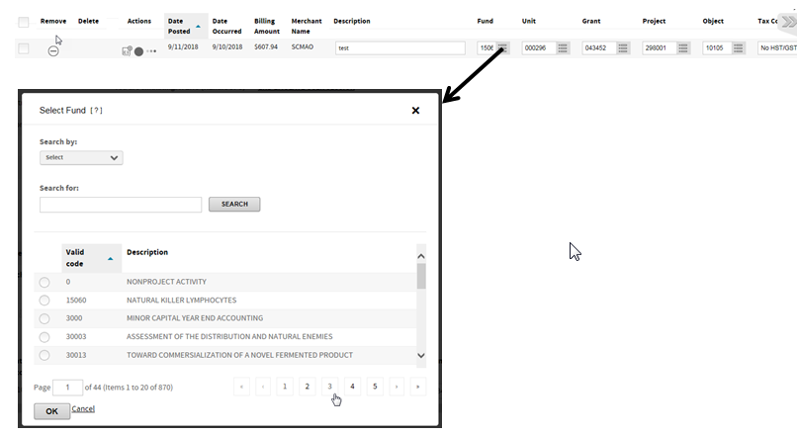
CentreSuite: Creating and Submitting Expense reports (continued)
3 C. You can type code or click on the icon to see a drop down menu of all codes. This is where you can also search for a specific code

Slide 9
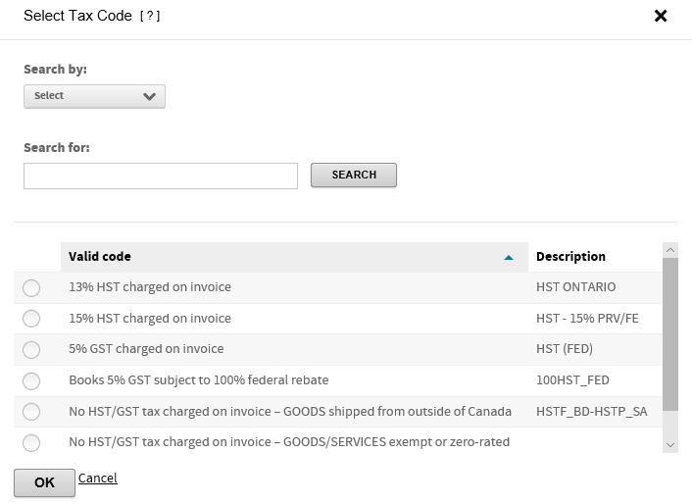
CentreSuite: Creating and Submitting Expense reports (continued)
3 D. Tax Code
See Appendix D for more training materials about how to select a Tax Code

Slide 10
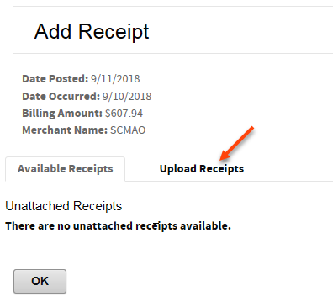
CentreSuite: Creating and Submitting Expense reports (continued)
How to add Receipts: A receipt must be added per transaction
By clicking the Receipt Icon shown above, you will be able to upload or select available receipts
Please note payment proof is not a receipt, receipt should show who is payee, for what goods/service, amount, tax (if applicable), date of transaction, method of payment

Slide 11
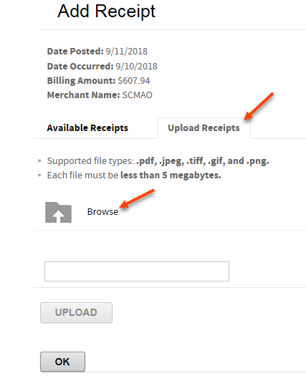
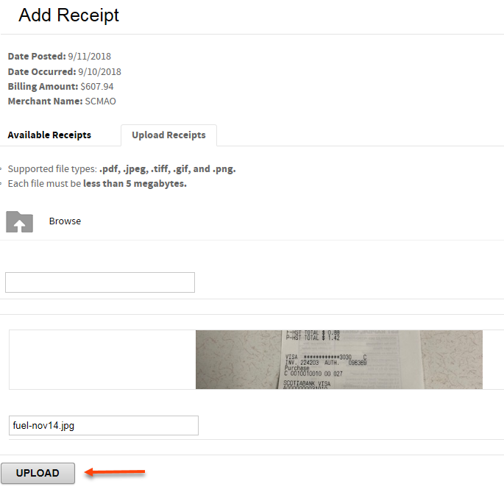
CentreSuite: Creating and Submitting Expense reports (continued)
Once you click on ‘Upload Receipts,’ Select Browse and locate the receipt
Click on Upload

Slide 12
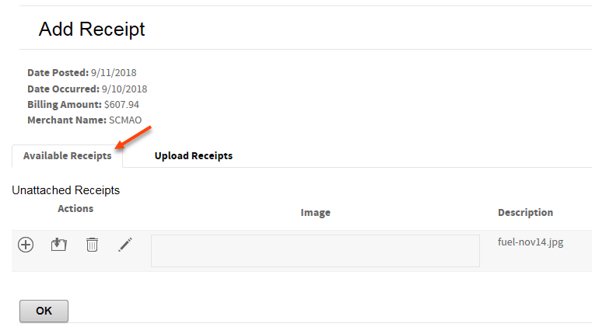
CentreSuite: Creating and Submitting Expense reports (continued)
Once the Receipt has been uploaded, you will need to attach it to the transaction
Click on ‘Available Receipts’

Slide 13
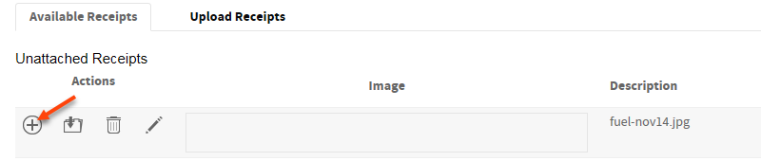
CentreSuite: Creating and Submitting Expense reports (continued)
The user can select which receipt they would like to attach that corresponds to the correct
Transaction:
A receipt has been added for the transaction below. These steps would need to be repeated for the other transactions.

Slide 14

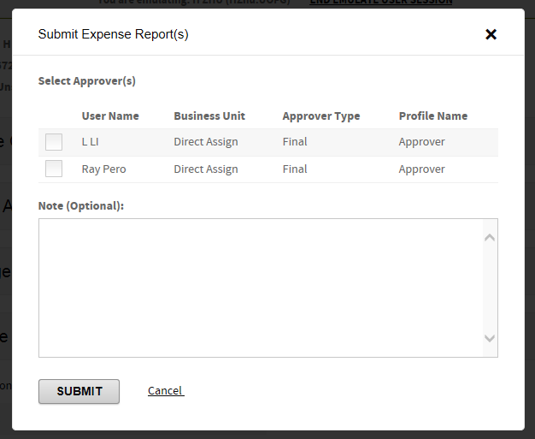
CentreSuite: Creating and Submitting Expense reports (continued)
4. Once descriptions are added, coding has been completed and all receipts have been attached. Please ensure to save expense report during this process, in order not to loose any information.
5. Click on “Submit
6. Select the Approver and click on ‘Submit.’

Slide 15
Keep Expense Report and Original Receipts
All P-card Expense Report and original receipts should be kept at department level. And they need to be retained for 7 years as per CRA requirement.
The electronic record and receipts are stored in scotia bank website for two years, the documents need to be transferred from scotia bank and saved to University’s driver every two years

Slide 16
Summary of Monthly Submission of Expense Report
Scotia Bank P-card statement is from 21st of previous month to 20th of current month. Depends on the number of transactions your P-card have, you can code the transaction on weekly or monthly basis.
The deadline for reconciliation to be completed is 24th. The “completed reconciliation” means 1. All the transactions are reviewed, receipts are loaded to each of the transactions; 2. Descriptions, GL string, Tax are selected based on the receipts; 3. Expense report is submitted and approved.

Slide 17
Escalate and Audit procedure
  It is the Card holder’s responsibility to reconcile the P-card statement accurately and on timely manner
  In order to make sure the quality of GL coding and tax coding, Treasury department will run monthly report to sample audit if the monthly reconciliation is done accurately and in timely manner.
  When the reconciliation is completely missed or tax code is not reviewed, card holder will be reached to by Treasury for a training session. However if a card holder consistently miss it, he/she will loose the card, because this can lead to significant tax risk for UofG.

Slide 18
Seeking professional help
If you need help understand the steps of reconciliation, tax code selecting, or any other matter about P-card, please email: treasury@uoguelph.ca

Slide 19
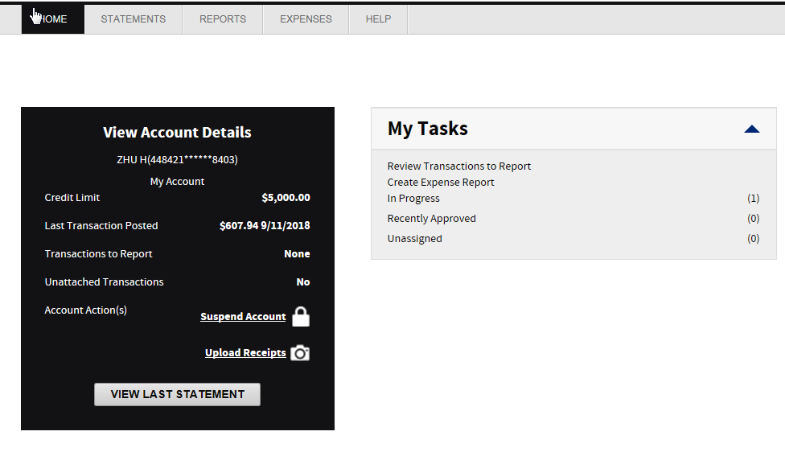
Appendix A – Home Page
The Home page contains summary information about your cards and the cards you manage
  Card Credit limits
  Last Transaction posted
Under “My Tasks”:
  You can jump to your transactions
  Create a new Expense Report
  Review an existing Expense Report
  View recently approved Expense Reports

Slide 20
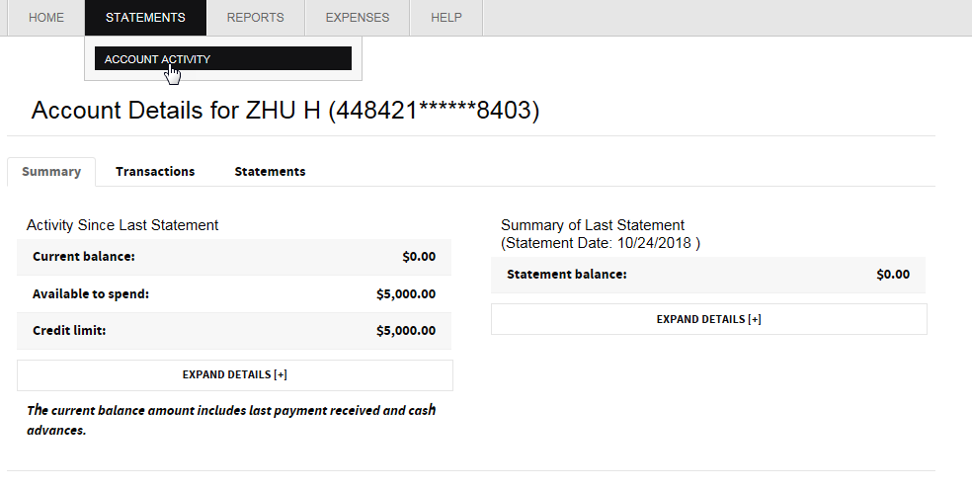
Appendix B –Statements & Review Account Activity
Account Balance and Activity can be confirmed by clicking on the “account summary” button

Slide 21
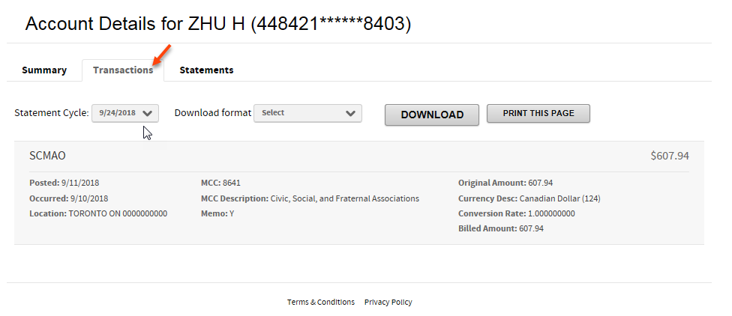
Appendix B –Statements & Review Account Activity
Recent transactions can be seen by clicking on the “Transactions” tab

Slide 22
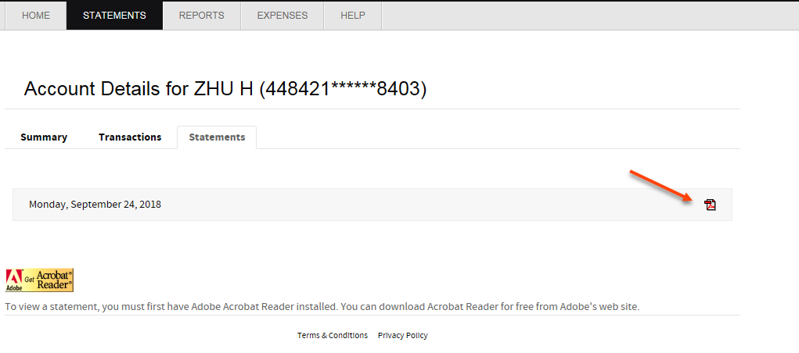
Appendix B –Statements & Review Account Activity
The Card program provides Electronic statements.
  Statements are accessible on CentreSuite online for 6 months.
1. Click on the ‘Statements’ tab for the cards you manage from the Review activity screen. Then click on the PDF icon to open the
The statement is only used to reconcile your expense report.
No payment to the Bank is required.

Slide 23
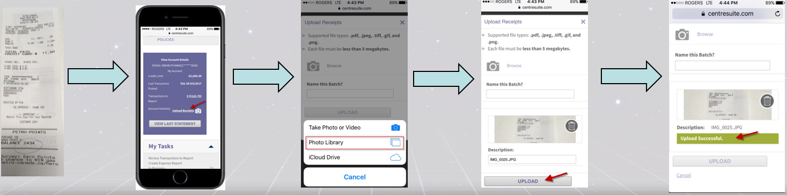
Appendix C – Uploading Receipts using Mobile Device
- Take a picture of the receipt on your mobile device
- Login to CentreSuite from your mobile device
- Click on ‘Upload Receipts’ on the homepage
- Select the image from your photo library
- Click on ‘Upload’

Slide 24
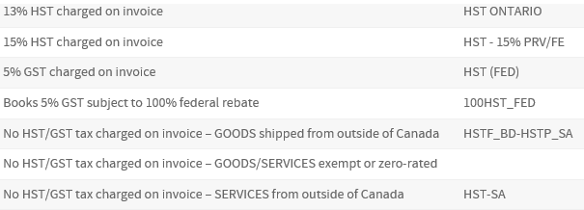
Appendix D – Tax coding
There are 7 categories tax coding you can choose for each transaction, next page will present you the decision tree for tax coding
①
②
③
④
⑤
⑥
⑦

Slide 25
Appendix D – Tax coding (continued)
Decision tree for tax coding:
Where the purchase or service come from
Domestic
Import
Based on the invoice/receipt tax amount, to select:
13% HST
15% HST
5% GST
Books * 5%GST
No HST/GST tax charged invoice – Goods/Service exempt or zero-rated
If the purchase is tangible goods, select: No HST/GST tax charged invoice – Goods shipped from outside of Canada;
If the purchase is service, or intangible like copyright, license, select: No HST/GST tax charged invoice – Service from outside of Canada
No HST/GST tax charged invoice – Goods/Service exempt or zero-rated
⑤
①
②
⑦
③
④
⑥
⑥
* Books noted here is only for printed book, not electronic or CD books

Slide 26
Appendix D – Tax coding (continued)
No HST/GST tax charged invoice – Goods/Service exempt or zero-rated
⑦
The tax exempt services most commonly purchased by Guelph are:
Financial Services (such as banking or insurance)
Services provided by other Universities or Hospitals
Municipal Services (public transit etc.)
The zero rated goods most commonly purchased by Guelph are:
Most Agricultural Equipment and Supplies (tractors, seeds, grains, fertilizer etc.)
Medical Devices & Prescription Drugs
Basic Groceries (mainly purchased by Food Services in order to make food sales)
International transportation
Rule of thumb: If it is domestic purchase, if there is no HST/GST on receipt, please select this tax type

Slide 27
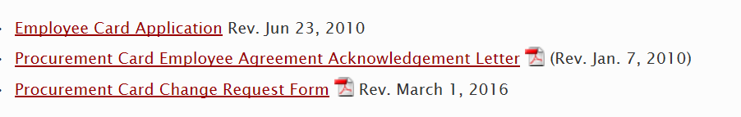
Appendix E – Forms
Link to On-line P-card forms:

