Slide 1
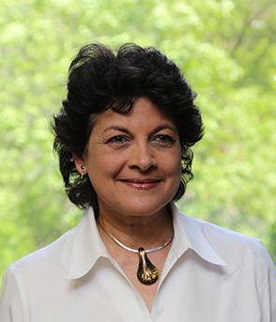




Prem’s Positivity Project in HHNS
Help a Child Succeed
Save the Date:
Thursday, June 13th from 11.30 am – 1.30 pm
Location: Room FS146 (HNRU)
Lunch Buffet, Ice Cream Sundaes, Cake & more
Fundraising to help support up to 600 kids
Breakfast Program
School Supplies
Summer Camps
Early-On 0-6 years Program
Youth 6-16 years After School Program
Raffle Prizes
https://shelldale.ca/ways-to-give
Admission tickets: Students $10; Others $20

