Slide 1



Job Evaluation Submission and Request for Reconsideration Process Guide
Professional Staff Association Job Evaluation Committee
Updated: January 22, 2025
Notes:
Today we will be walking you through the Job Evaluation Submission and Request for Reconsideration Process for the Professional Managerial employee group. We will discuss what it is, what it’s used for, the necessary steps and the documentation requirements.

Slide 2
Job Evaluation Submission Process
For a position to be evaluated, the supervisor will initiate the job evaluation process by submitting a Job Fact Sheet (JFS) to Human Resources and the Professional Staff Association Job Evaluation Committee (“Committee”).
The Committee is comprised of three (3) University of Guelph representatives and three (3) Professional Staff Association representatives.
There must be at least two (2) representatives from each side in attendance for quorum to be achieved and the meeting to proceed.
Jobs are carefully reviewed by both sides and joint decisions are made.
It is not the role of the Committee to assign salary bands to jobs but rather to assign the appropriate grade factors.
Notes:
For a position to be evaluated, the supervisor will submit a Job Fact Sheet to Human Resources and the Professional Staff Association Job Evaluation Committee.
The committee is comprised of 3 University of Guelph Representatives and 3 Professional Staff Association representatives
There must be at least 2 representatives from both sides in attendance at the meeting in order to achieve quorum. If sufficient attendance is not possible, the meeting is typically either rescheduled to the next available date/time when all the necessary members can attend, or it is delayed to the following month’s prescheduled time.
The purpose of the committee is to ensure that jobs are reviewed in a fair and equitable manner, utilizing other roles on campus as benchmarks and/or comparators. It is not the role of the committee to assign each role a salary band but rather, to assign the appropriate grade factors by reviewing the duties and responsibilities outlined in the JFS. Each grade factor is weighted, and the sum of all assigned grade factors corresponds to a salary band.

Slide 3
Job Evaluation Submission Process (cont’d)
For a position to be evaluated, it must be RFT or TFT, greater than 2 years of duration and it must meet one of the following scenarios:
A new position where the incumbent has been in the position for at least six (6) months;
An existing position which has not been evaluated in at least five (5) years; or
A position has changed significantly.
Typically, it is necessary for an incumbent to be in the role for 6 months prior to submitting a formal review so that there is ample time for both the supervisor and incumbent to become comfortable with the role and make tweaks to the job fact sheet prior to submitting.
For jobs that are TFT with a duration of less than 2 years, Human Resources manages the formal evaluation process.
Notes:
For a position to be evaluated by the Committee it must be RFT or TFT greater than 2 years and it must meet one of the following scenarios:
A new position where the incumbent has been in the position for at least six (6) months;
An existing position which has not been evaluated in at least five (5) years; or
A position has changed significantly.
Typically, it is necessary for an incumbent to be in the role for 6 months prior to submitting a formal review so that there is ample time for both the supervisor and incumbent to become comfortable with the role and make tweaks to the job fact sheet prior to submitting.
For jobs that are TFT with a duration of less than 2 years, Human Resources manages the formal evaluation process.

Slide 4
Job Evaluation Submission Process (cont’d)
For a position to be evaluated, the following documents must be submitted:
Job Fact Sheet (signed by incumbent, supervisor and Dean/Director)
Organization Chart
Memo (detailing reason for evaluation)
If a role is multi-incumbent, the JFS must be signed by all represented incumbents.
Once the evaluation is complete, the results will be communicated to the supervisor who will then share the outcome with the incumbent.
If there is disagreement with the outcome of the evaluation, the supervisor can initiate a request for reconsideration.
Notes:
For a position to be evaluated, the following documents must be submitted:
Job Fact Sheet (signed by incumbent, supervisor and Dean/Director)
Organization Chart
Memo (detailing reason for evaluation)
If a role is multi-incumbent, the JFS must be signed by all represented incumbents.
Once the evaluation is complete, the results will be communicated to the supervisor who will then share the outcome with the incumbent
If there is disagreement with the outcome of the evaluation, the supervisor can initiate a request for reconsideration.

Slide 5
What is Request for Reconsideration?
If there is disagreement regarding the results of the of the job evaluation, the supervisor may request that the evaluation be reconsidered.
Notes:
What is a Request for Reconsideration?
If there is disagreement regarding the results of the of the job evaluation, the supervisor may request that the evaluation be reconsidered.

Slide 6
Grounds for Request for Reconsideration
A request for reconsideration may be initiated if:
  An important aspect of the job content information was omitted from the Job Fact Sheet (JFS)
  The grade score for any job evaluation factor is inappropriate and substantiating facts to indicate the reason why is provided.
If the position that the incumbent is holding has changed significantly since the original submission of the Job Fact Sheet (JFS), then a new JFS should be completed and submitted through the re-classification procedure instead of proceeding with a request for reconsideration.
Notes:
What are the grounds to submit a Request for Reconsideration?
A request for reconsideration may be initiated if:
An important aspect of the job content information was omitted from the Job Fact Sheet.
The grade score for any job evaluation factor is inappropriate and substantiating facts to indicate the reason why is provided.
If the position that the incumbent is holding has changed significantly since the original submission of the Job Fact Sheet (JFS), then a new JFS should be completed and submitted through the re-classification procedure instead of proceeding with a request for reconsideration.

Slide 7
Request for Reconsideration Procedure
An RFR may be initiated after the results of the Committee have been communicated.
The RFR should be sent to the Committee care of Human Resources within 15 working days of receiving the results of the Committee. Extensions may be granted in extenuating circumstances, such as prescheduled vacation and sickness.
The Request for Reconsideration form can be downloaded from the website at: https://www.uoguelph.ca/hr/managers-job-design-job-evaluation/job-evaluation-forms
A separate form is required for each factor deemed to be inappropriate. The incumbent/supervisor needs to fill out the form(s) giving the desired grade and the reasons why.
If selecting a grade higher than what has been rated by the Committee, please ensure that you are able to meet the full definition for all grades in between. For example, if the job has been rated with a 2 in Contacts but you believe it to be a 4, please ensure that you are able to meet the definition of the 3 and the 4.
Please refer to Appendix A to see an RFR form.
Notes:
Here is an outline of the Request for Reconsideration procedure.
A RFR may be initiated after the results of the Committee have been communicated.
The RFR should be sent to the Committee care of Human Resources within 15 working days of receiving the results of the Committee. Extensions may be granted in extenuating circumstances, such as prescheduled vacation and sickness.
A request for reconsideration form can be downloaded from the University of Guelph’s Job Evaluation website which is shown here.
A separate form is required for each factor deemed to be inappropriate. The incumbent/supervisor needs to fill out the form(s) giving the desired grade and the reasons why.
If selecting a grade higher than what has been rated by the Committee, please ensure that you are able to meet the full definition for all grades in between. For example, if the job has been rated with a 2 in Contacts but you believe it to be a 4, please ensure that you are able to meet the definition of the 3 and the 4.
Please refer to Appendix A to see what a RFR Form looks like.

Slide 8
Request for Reconsideration Procedure (cont’d)
The Committee will consider the request and make a decision. The decision the Committee makes could result in an increase, a decrease or no change in overall points thus the value of a position could move up or down or remain the same at this stage.
Please note that adjustments in grades may not be significant enough to move the position to a different pay/salary band.
For multi-incumbent positions, any Committee decision on a RFR will affect all the incumbents in that position.
The decision of the Committee, which is final and binding, will be communicated to the supervisor who will then share the results with the incumbent(s).
If there is an increase in salary grade, retro pay will typically coincide with the JE submission date.
Appendix B outlines the overall job evaluation and RFR process.
Notes:
The Committee will consider the request for reconsideration and make a decision. The decision the Committee makes could result in an increase, a decrease or no change in overall points thus the value of a position could move up or down or remain the same at this stage.
Please note that adjustments in grades may not be significant enough to move the position to a different pay/salary band.
For multi-incumbent positions, any Committee decision on a request for reconsideration will affect all the incumbents in that position.
The decision of the Committee, which is final and binding, will be communicated to the supervisor who will then share the results with the incumbent(s).
If there is an increase in salary grade, retro pay will typically coincide with the Job Evaluation submission date.
Appendix B outlines the overall job evaluation and Request For Reconsideration process.

Slide 9
Appendix A
Request for Reconsideration Form

Slide 10
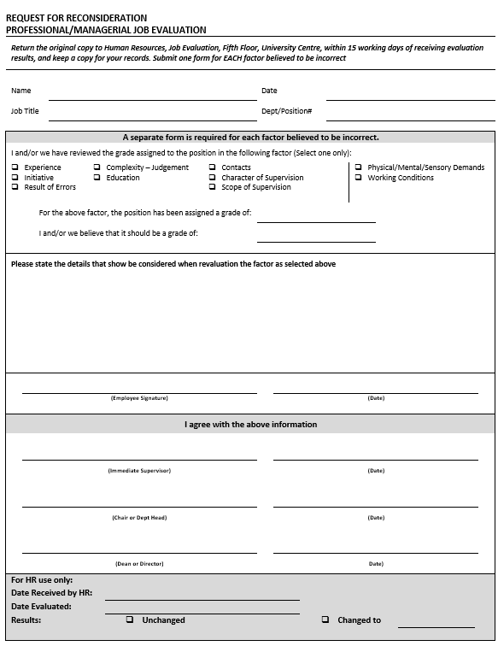
Request for Reconsideration Form
Notes:
Here is a sample of the Request for Reconsideration form for your reference.

Slide 11
Appendix B
Job Evaluation and Request for Reconsideration Process

Slide 12
Job Evaluation and RFR Process
Job has changed significantly
New / changed job for Job Evaluation
Supervisor submits
documents
Committee evaluates position
HR Communicates the results
Supervisor agrees with results
Payroll processes Retro-pay*
(if applicable)
Supervisor disagrees with results
No further reconsiderations are permitted
RFR submitted within 15 days
Supervisor
submits
Reconsideration Form
HR communicates final results
Payroll processes Retro-pay*
(if applicable)
*The retro effective date typically coincides with the JE submission date.
Notes:
This slide illustrates the Job Evaluation and Request for Reconsideration process.

Slide 13
The End.
Notes:
This concludes our presentation. If you have any further questions, please do not hesitate to contact Human Resources.
Thank you for your time and attention.

